Slide 1

Snap-shot of TB public health research in Blantyre
Plus
HIV-self-testing
Community-led HIV self-testing cluster-randomised trial in Malawi (and Zimbabwe)
Liz Corbett
LSHTM and Malawi-Liverpool-Wellcome (MLW)
Wellcome Trust - Bloomsbury Centre for Global Health Research Scientific Meeting
16-Mar-2022
Gambia

Slide 2
Outline
TB research group in MLW, Blantyre Malawi
- past and future directions
HIV self-testing
- overview
- one of 10 randomized trials of self-testing 2012-20
- Community-led intervention in Malawi

Slide 3
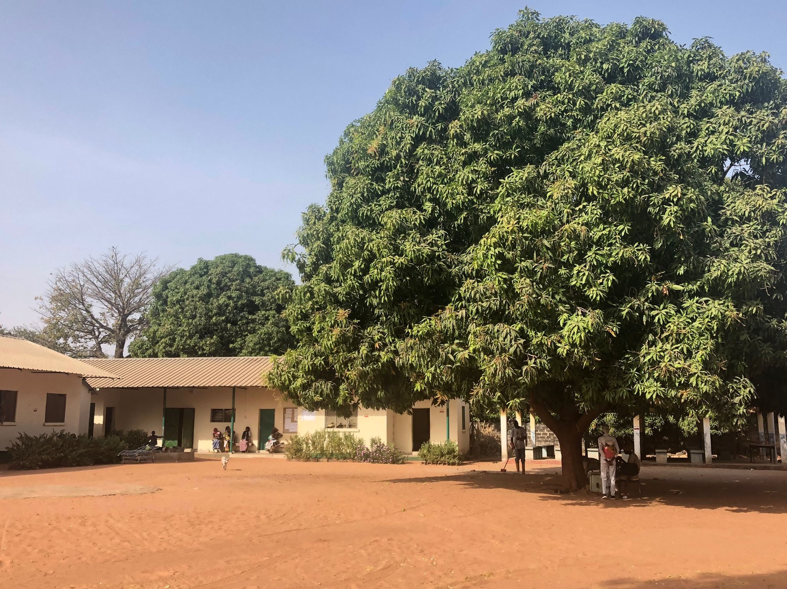
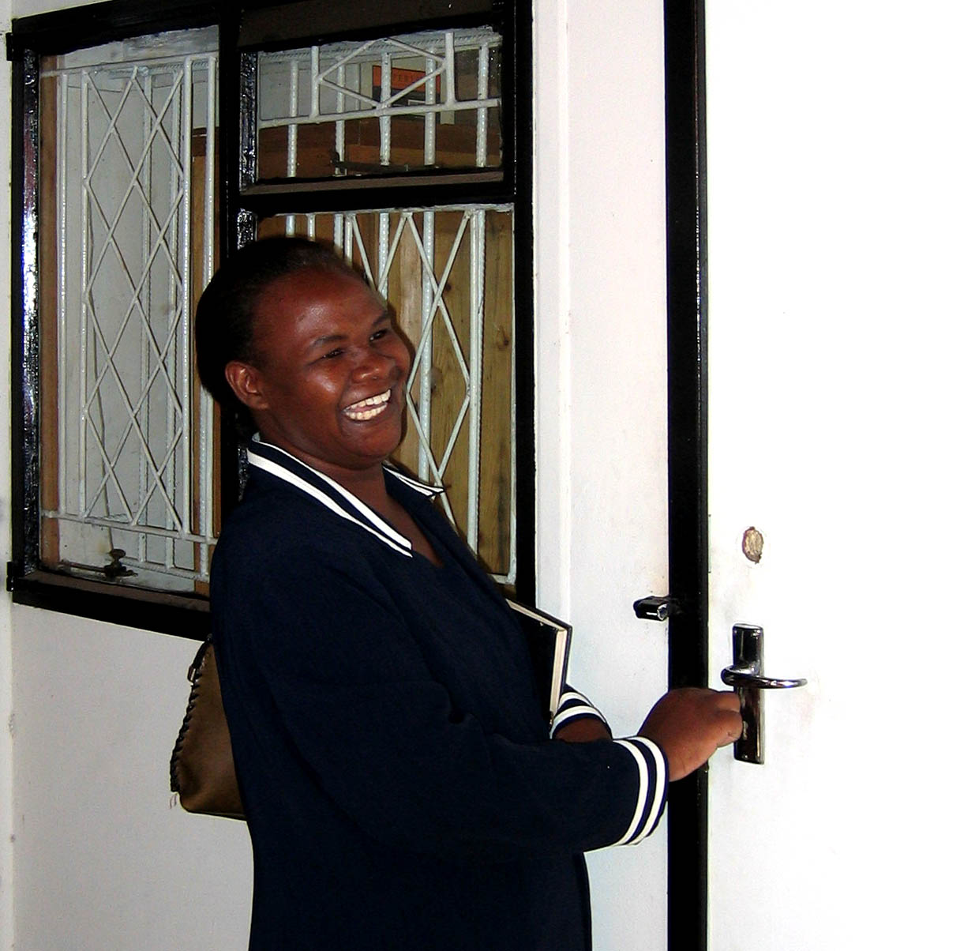
Thank you to MRC Gambia and meeting organisers!
Sorry to be missing you Harare!

Slide 4
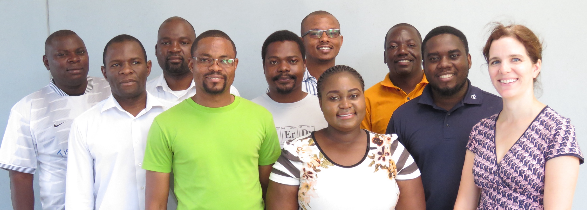

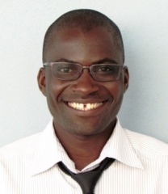
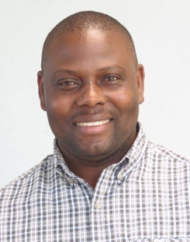
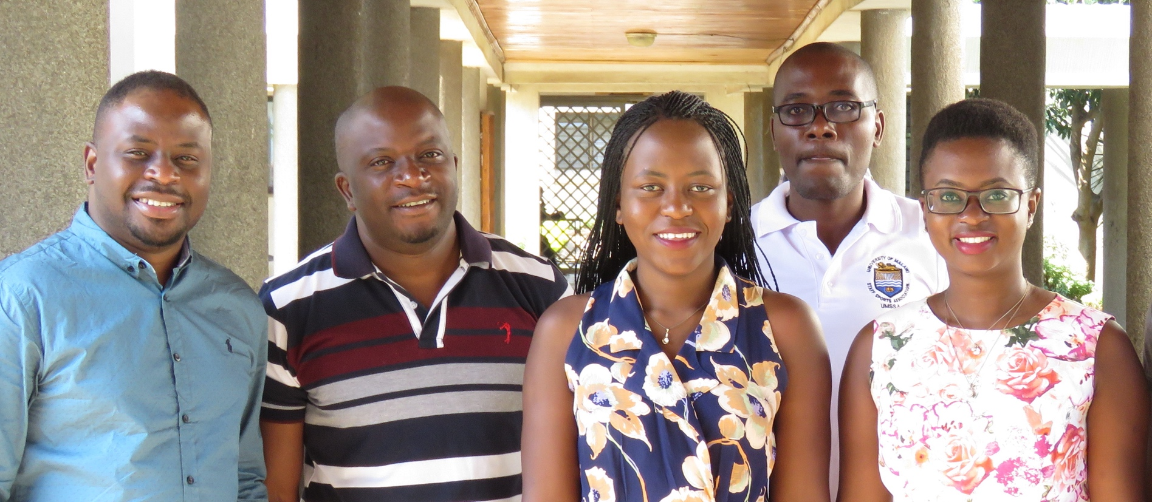
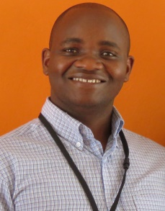
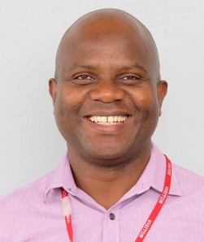
Peter MacPherson
Public Health Group
MLW Programme
Research groups in both MLW
and College of Medicine
Dr Augustine
Choko
Dr Moses
Kumwenda
Marriott Nliwasa
TB/HIV Research Group
College of Medicine
Dr Titus
Divala
Dr Victor Ndlovu

Slide 5
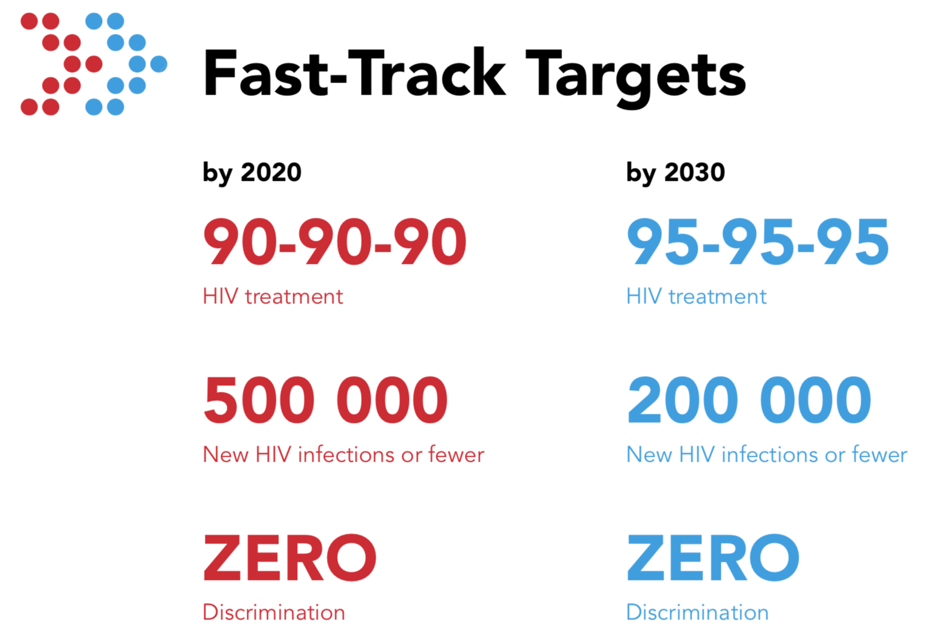
Progress towards 95-95-95
Undiagnosed HIV, as % all PLHIV,
globally: “First 90”
Rapid progress towards “First 90”
  Still a fraction of cost of providing care
  Still the biggest gaps in care cascades
Diversified and decentralized services
  ~150 million HIV tests p.a.
  New strategies including
    HIV self-testing
    Index testing (Assisted partner notification)
2020 HIV
New infections: 1.5 mil
(from 3 mil in 1997)
HIV deaths: 0.68 mil
(from 2 mil in 2005)
2020 TB
New disease: 9.9 mil
TB deaths: 1.5 mil
including 31% of all HIV deaths
UNAIDS Gap Report 2021

Slide 6
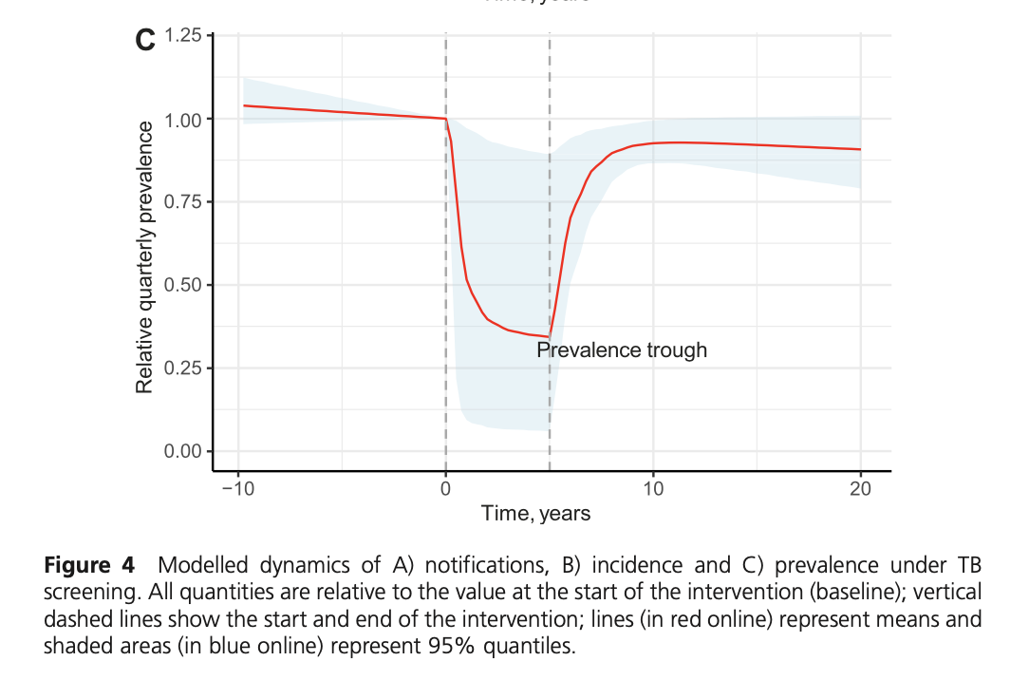
Diagnostic interventions – across health system
Ongoing problems with TB diagnosis at every level of Health System
Prevalence surveys ~1% adults culture+ in Southern African & some Asian Cities
People reporting TB symptoms in high HIV communities
High prevalence of undiagnosed TB & HIV
Community active case-finding
Rapid reduction in undiagnosed culture+ TB
Harare: 43% reduction low cost strategy (symptoms + smear microscopy)
Vietnam: 45% reduction 4 years of annual molecular testing regardless of symptoms
Meta-analysis 260,000 participants with TB symptoms screened for both undiagnosed TB and HIV
Telisinghe IJTLD 2022
Community
6.9%
(n=12)
Primary care
20.5%
(n=23)
36.4%
Mixed
(n=15)
Hospital
34.8%
(n=9)
0
25
50
75
100
Undiagnosed TB prevalence (%)
Horton PLoS Med 2016, Corbett Lancet 2010, Marks NEJM 2020
Nliwasa JIAS 2018

Slide 7

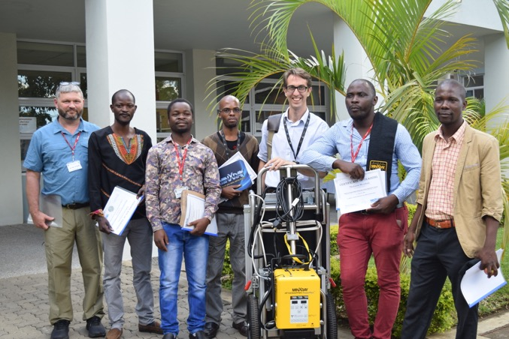
Routine TB diagnosis at primary care level
Helena Feasey
Clinic-based screening
Far from efficient or same-day!
Exit interviews: 2346 primary care patients,
Blantyre Malawi, 2018
Clinic has Xpert & microscopy
But 1/3rd of all attendees have cough
MacPherson PLoS Med 2021
Feasey BMC ID 2021

Slide 8
TB surveillance and interventions Blantyre: 2011-21

Slide 9

Mapping and door-to-door census enumeration
Comm Health worker
Catchment areas + head count
315
Neighbourhoods
All
753,489
People (2015)
TB registration clinics

Slide 10

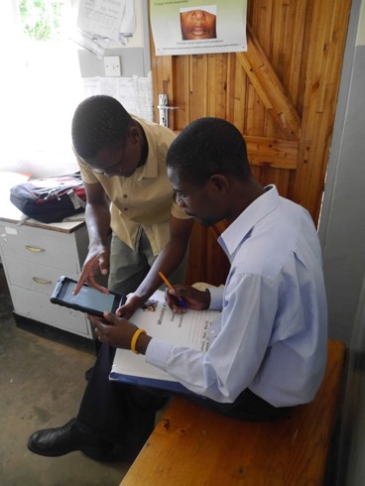



Enhanced TB surveillance
All 15 TB registration clinics in Blantyre
- Ministry of Health TB Officers
From registering TB cases:
1
2
3
Demographics &
Clinical info
TB culture &
smear
Geolocation of
household

Slide 11
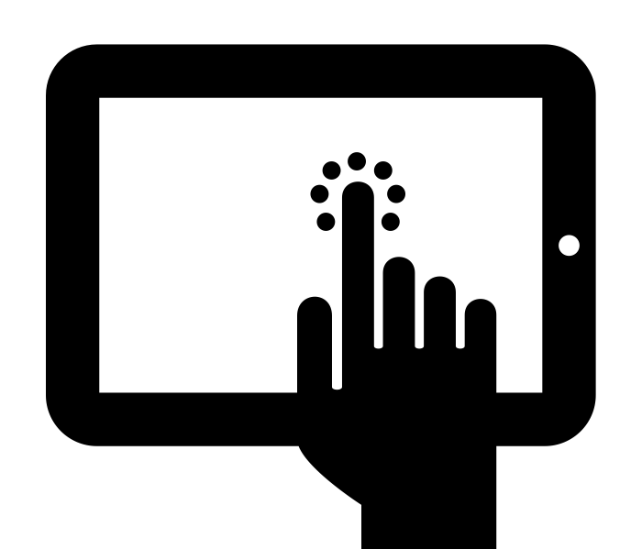

ePAL geolocation
You can zoom in. Look, we have marked your local church
Clinic based capture of geospatial coordinates
- downloaded, searchable satellite map
ePAL
MacPherson BMC ID 2016
Rebecca Harris, Helena Feasey & Luke Banda

Slide 12
Impact of interventions

Slide 13
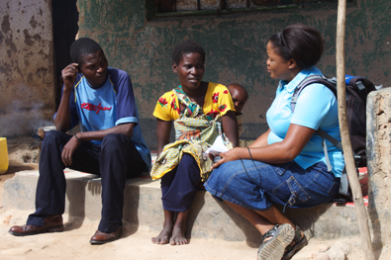
Sustainable Community Action for Lung HEalth (SCALE)
Helena Feasey
Community-wide active case-finding
Conditional recommendation WHO 2013 & 2022
Research Questions
Can symptoms-plus-smear-based ACF for undiagnosed TB meet the urgent need for improving TB control?
  undiagnosed TB too low for hard endpoints
    ART scale-up
    National TB program TB X-ray and Xpert vans
  Amended endpoints interrupted by CV19
Undiagnosed culture+ TB
per 1000 adults
Harare 2009: 6.7 /1000
Blantyre 2014: 7.8 /1000
Blantyre 2019: 2.1 /1000
WHO GDG Systematic reviews:
Feasey BMJ Global Health 2022, Burke Lancet Public Hlth 2021

Slide 14
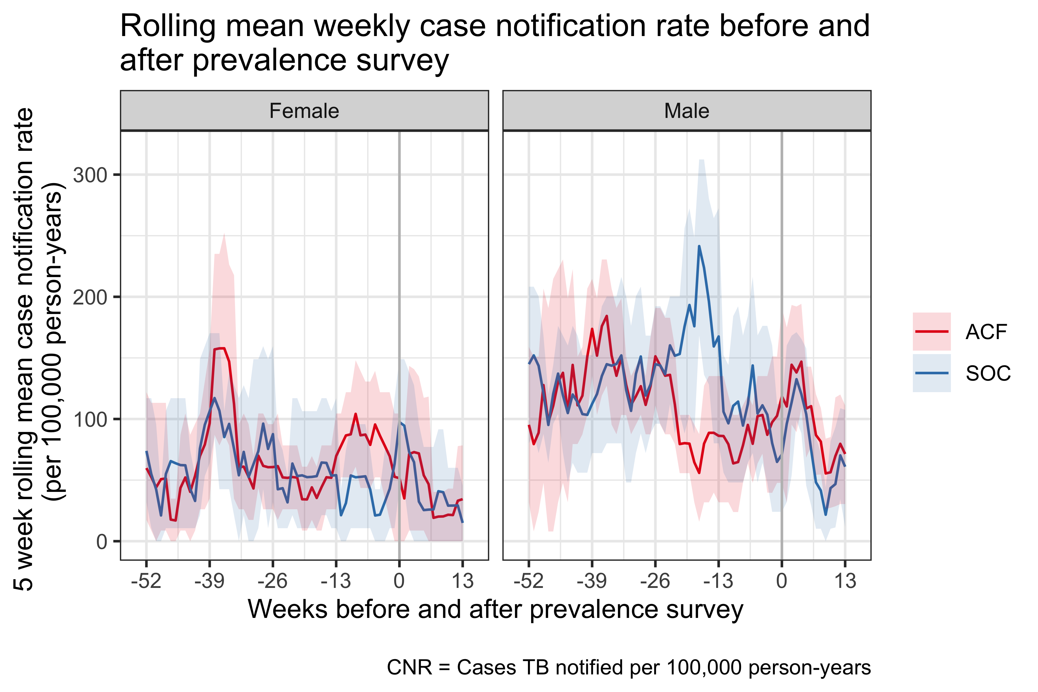
Sustainable Community Action for Lung HEalth (SCALE)
Helena Feasey
Project TB case-finding
NTP case-finding
Xray vans + Xpert
HIV programme
HIV testing & ART
1 round of brief enquiry for TB symptoms before CV19 with sputum for microscopy
No evidence of case-finding “peak”
Modelling data suggest undiagnosed TB takes time to build up after successful case-finding campaigns
Rachael Burke and Marriott Nliwasa – reanalysis in prep

Slide 15
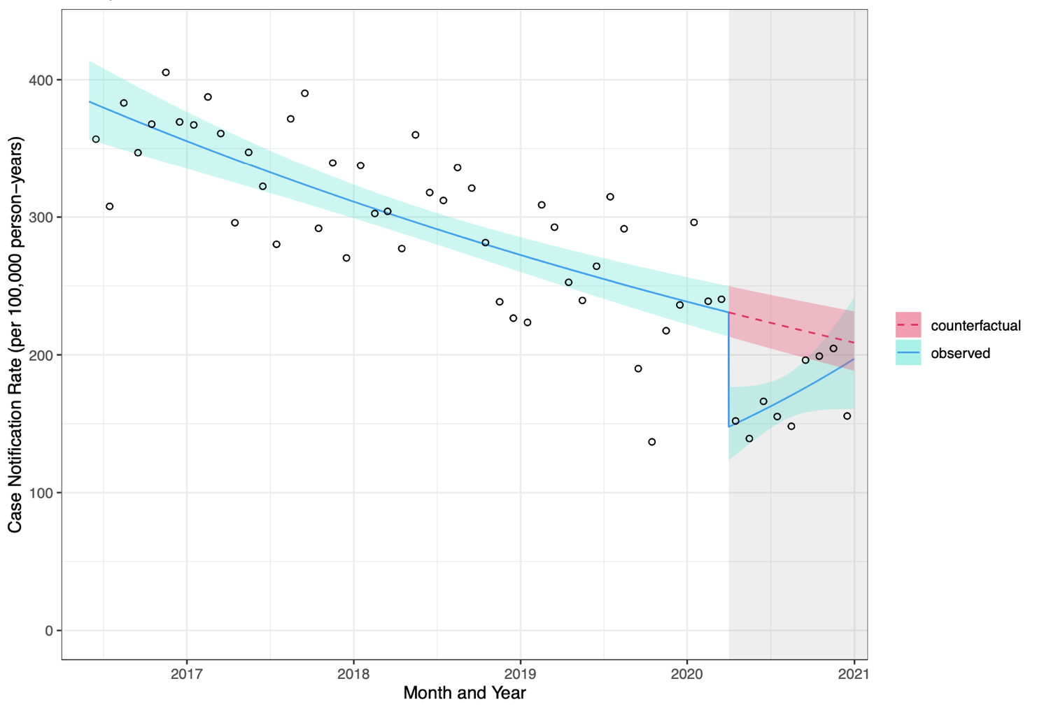


2017-21 TB in decline... and impact of COVID-19
Rachael Burke
Rebecca Nzawa
333 fewer TB notifications with COVID-19
(95%CI: 291 to 376)
24% reduction all cases
(95%CI: 21 to 26%)
All TB cases at any age
- COVID-disruptions
- women > men
- primary clinic > hospital
- HIV-ve > HIV+ TB
Nzawa Burke Emerging Infect Dis 2021

Slide 16
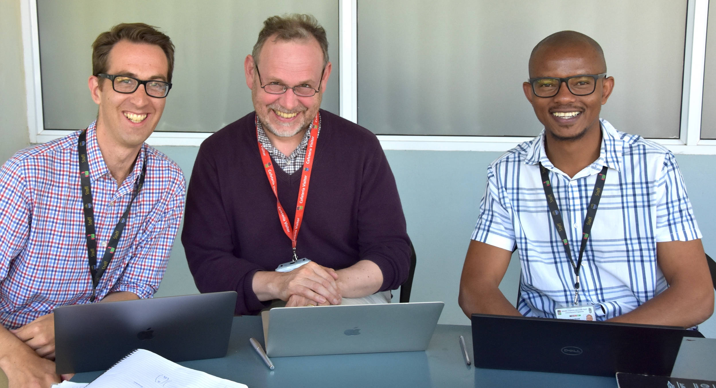
Spatial epidemiology

Slide 17
Defining determinants of disease heterogeneity
Likely substantial spatial heterogeneity in disease epidemiology, even within high transmission urban settings
  DETERMINANTS OF ACCESS
  TO DIAGNOSIS AND CARE
SOCIAL DISEASE DETERMINANTS
HIV
SPATIAL HETEROGENEITY IN
EPIDEMIOLOGY

Slide 18



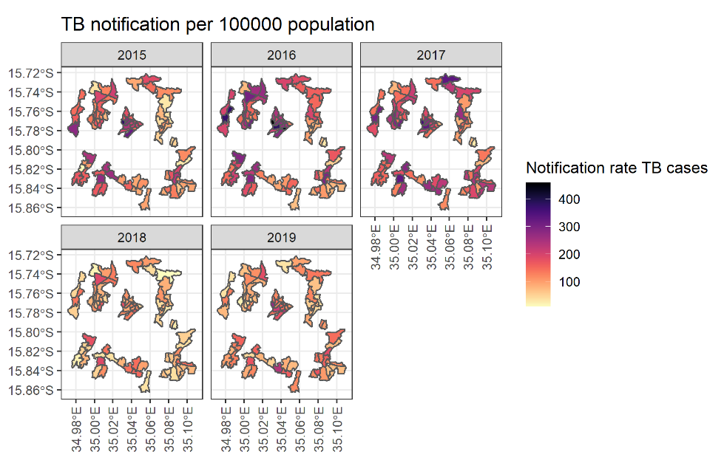
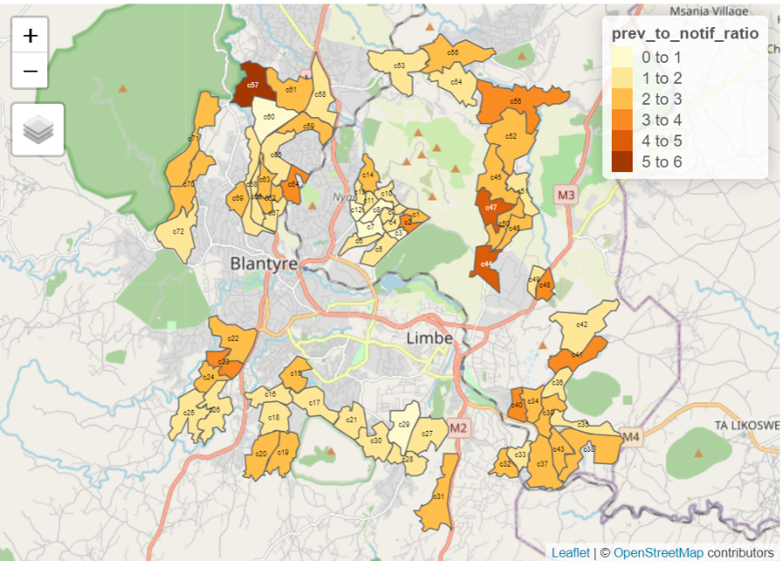
Spatially targeted TB interventions
McEwen Khundi
Peter
MacPherson
McEwen
Khundi
James Carpenter
Using Routine TB programs and TB prevalence data to identify TB hotspots
High ratio of prevalence to notification rates of TB in populous outskirt areas of the city, Bangwe, Chilomoni Chilimba and Sochi
MacPherson BMC Medicine 2016, Khundi Epi Infect 2021

Slide 19
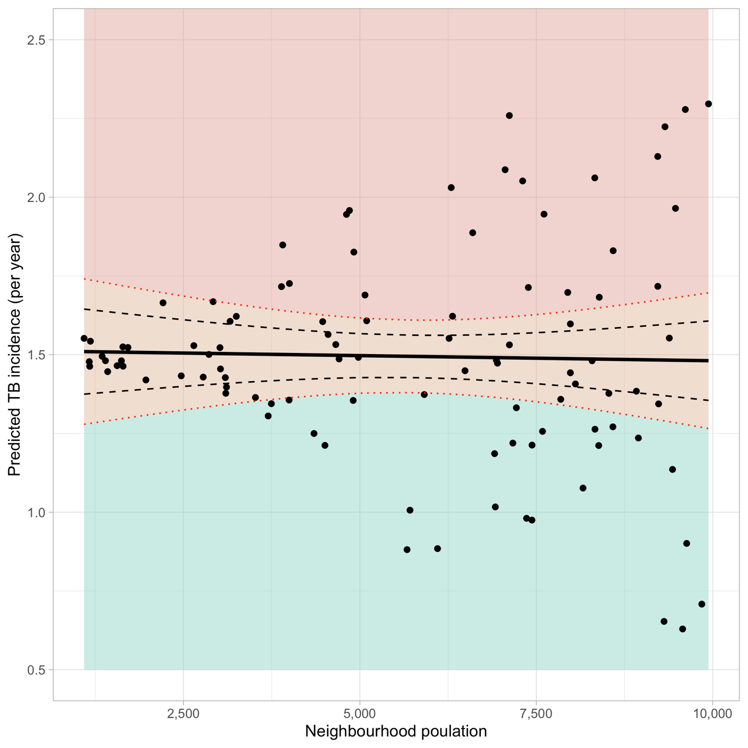
Statistical “triggers” for local public health action
NEIGHBOURHOOD INPUTS
PREDICTIVE MODEL
PUBLIC HEALTH ACTION
Demographic data
Hotspot detection
Statistical exceedances
Active case finding
Disease risk profile
Intensified prevention
(e.g. HIV)
Surveillance data
(Notifications/mortality)
Health facility strengthening

Slide 20
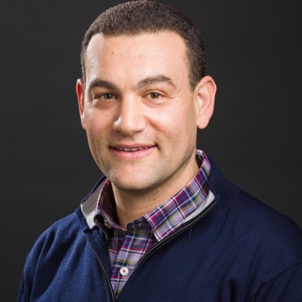
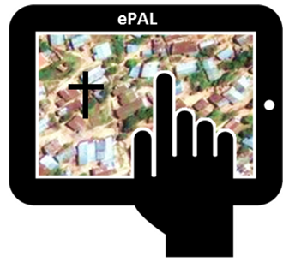


BLAST: TB transmission using whole genome sequencing
NIH R01
Ted Cohen
2015
2016
2017
Enhanced case
surveillance
Prevalence of TB risk
factors and disease
Microbiology &
genomics
Spatiotemporal Bayesian modelling
Modelling impact of TB/HIV/public health interventions
Statistical/epidemiological triggers for targeted case-finding
Better outcome measures of TB control interventions
TB CNR per 100,000

Slide 21
HIV surveillance and spatial mapping
Burke AIDS 2021 – declining HIV-related admissions
Burke IAS - submitted
- resolving HIV trends in Blantyre

Slide 22
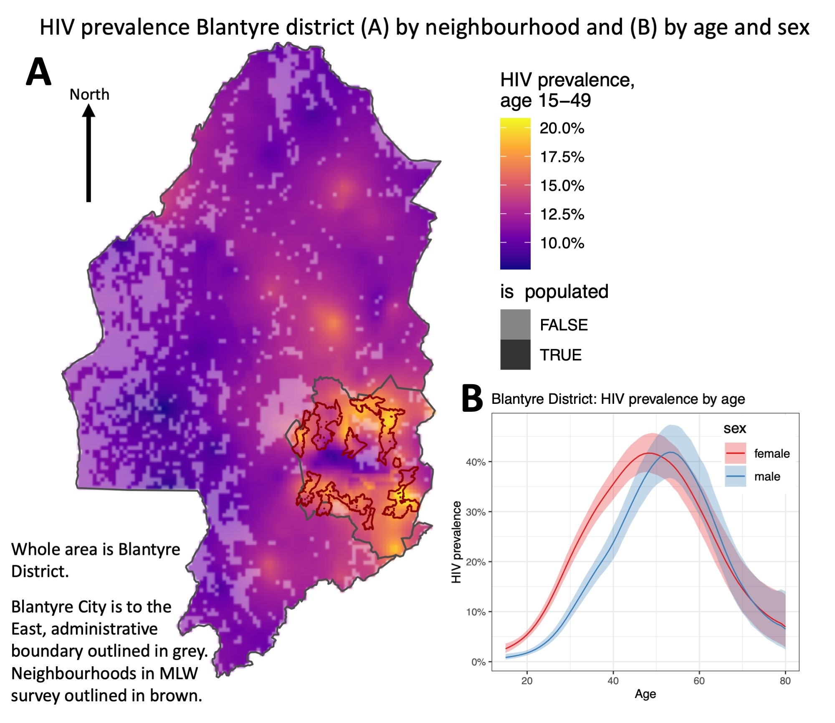


Spatial HIV in Blantyre – periurban + aging epidemic
HIV prevalence Blantyre District
HIV prevalence (B) highest in
women aged 49 - 45%
men aged 54 - 45%
Peri-urban Blantyre
Rachael Burke
Spatially explicit Bayesian
(INLA model)
Peter MacPherson
City
HIV prevalence – age/sex
Andreas Jahn (MoH)
Jeff Eaton (Imperial)

Slide 23
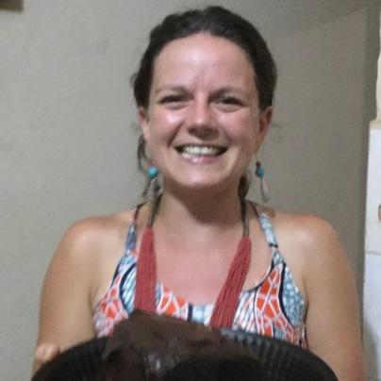

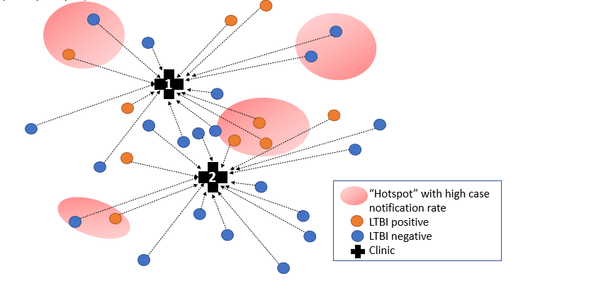
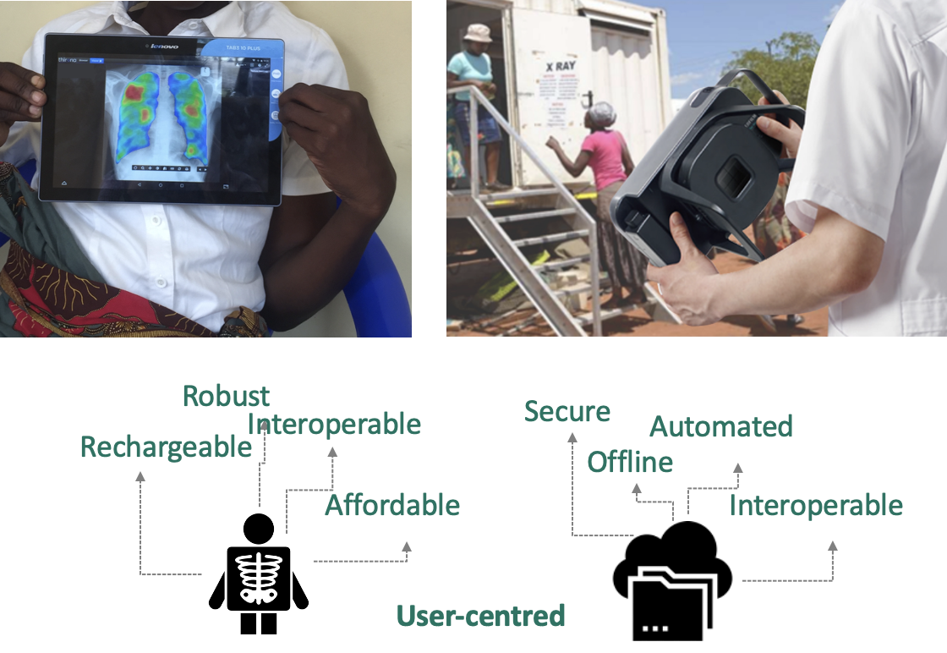
What next for TB in Blantyre?
TB infection in U5Y clinics: evidence-based preventive therapy for young children
AND facility-based “hot spot” surveillance data complementary to analyses based on diagnosed TB cases
robust to diagnostic access barriers
Digital CXR + computer assisted diagnostics
Unitaid (awarded - Liverpool School)
Surveillance + targeted city-wide TB and HIV elimination: Wellcome (building on BLAST)
Hannah Rickman
Peter MacPherson

Slide 24
HIV self-testing
Wellcome Fellowships - 2009-23
Unitaid scale-up grants – 2015-21

Slide 25
HIV self-testing – first large evaluation, globally
Trial of HIVST in 16,660 adults in 28 intervention clusters in Malawi 2012-15
High uptake
Young people
Male participation
44% first-time testers
Early HIV & discordant couples
No major safety concerns
27,000 testing episodes
Women
Men
Immediate relevance to UNAIDS 2020
“90-90-90” targets
Tripled population demand for ART in 1st 6 mos of intervention
Months
Choko PLoS Med 2015 & PLoS Med 2011
MacPherson JAMA 2014
AIDS & Behavior Special Issue 2014
Mahesweran JIAS 2017
Witzel & Desmond JIAS 2016
16-19
20-29
30-39
40-49
50+
Age Group (years)
Notes:
Self-testing was initially embedded within a cluster randomised trial funded by the WT for intensified TB prevention
This shows very high overall uptake of HIV testing with self-testing but lower in older age groups especially men, a trend you see across Africa and actually even much lower with other testing strategies as reflected in a comparative report of HIV testing in SSA.

Slide 26
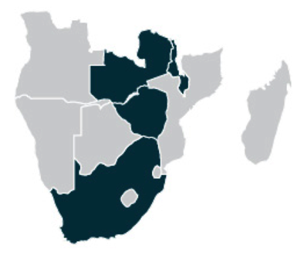







Catalysing HIV self-testing (HIVST):
UNITAID STAR high-level goals, 2015
Develop global normative HIVST guidelines
  Informed by multicountry project evaluation
  Released by WHO
National guidelines and algorithms to accommodate HIVST in all countries by end of project
≥1 HIV kit packaged for HIVST pre-qualified by WHO
Estimate market size and market landscape for HIVST
  Price reductions for quality-assured HIVST products

Slide 27
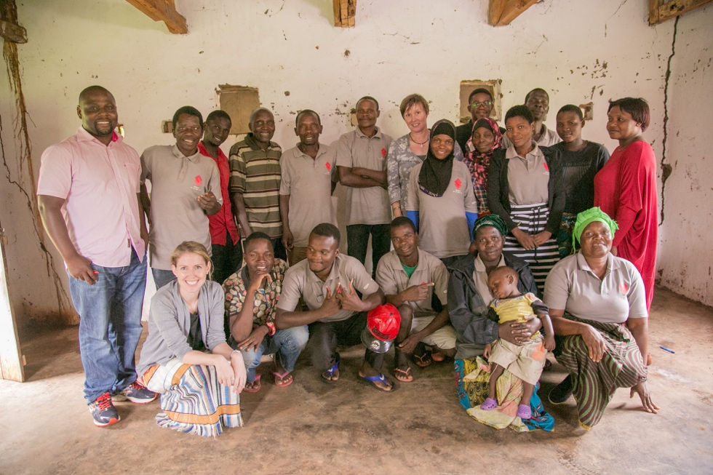
1 week campaign of Community-Led HIVST Malawi
- cheaper, better? Something to combine with Malaria bednet distrn?
30 GVH-defined clusters eligible for randomisation
Intervention arm
15 GVHs allocated to CL-HIVST
Communities supported to plan and implement HIVST campaign linked to HIV treatment and prevention.
Control arm
15 GVHs allocated to SOC
Continuation of MOH SOC, with HIV services provided through health facilities and community outreach.
Primary outcome: Lifetime HIV testing in adolescents 15-19 years
Secondary outcome:
Testing in the last 3 months in adults ≥ 40 years
Testing in the last 3 months in men
Cumulative incidence of ART initiation across 6 months
Measure of knowledge of HIV prevention
Measure of HIV testing stigma
Outcome measurement
Cross-sectional surveys at 8-12 weeks
Clinic data capture for 6 months

Slide 28
In practice
2-day workshop with community health action groups
2-day training with community volunteers
Material inputs
Understand drivers of HIV infection, including barriers to service utilisation
Define underserved sub-groups
Plan HIVST campaign, including: sensitisation, distribution of HIVST kits, linkage to treatment and prevention, HIV prevention messages, monitoring & evaluation
Develop competency to promote and support HIVST services, including: pre-test information, post-test support, social harms monitoring, data capture
Finalise HIVST campaign plan
HIVST kits
Informational materials
Data capture tools
US$10 gratuity
7-day HIVST campaign linked to HIV care and prevention delivered by community health action groups and community volunteers

Slide 29
CL Malawi – results from 1 week distribution campaign
Distribution: Distribution of 24,347 kits by 188 volunteers
Uptake: 74.4% (2956/3973) ever self-tested
Linkage: 2.4% (70/2951) tested positive; 37.3% (25/67) linked to confirmatory testing; 84.0% (21/25) started on ART
Social harms: 0.4% (12/2943) pressured to self-test’0.2% (7/2943) pressured to disclose self-test result
 | HIVST | SOC | Adj Risk Ratio¹ (95% CI), p-value
Lifetime testing in adolescents | 84.6% | 67.1% | 1.25 (1.10-1.43), 0.001
Stratified by age
15-17 | 79.8% | 57.2% | 1.45 (1.14-1.85), 0.004
18-19 | 88.3% | 75.0% | 1.16 (1.05-1.27), 0.004
P-value for interactio |  |  | 0.02
Stratified by sex
Boys | 79.7% | 57.3% | 1.40 (1.18-1.67), <0.001
Girls | 88.2% | 74.8% | 1.18 (1.03-1.33), 0.01
P-value for interaction |  |  | 0.01
 | HIVST | SOC | Adj Risk Ratio¹ (95% CI), p-value
 | % (n/N) | % (n/N)
Testing in last 3 months: adults≥40 | 74.5% | 33.9% | 2.21 (1.92-2.55), <0.001
Testing in last 3 months§; men | 74.2% | 31.6% | 2.37 (2.00-2.80), <0.001
Knowledge of HIV status in partners | 71.3% | 56.9% | 1.24 (1.08-1.42), 0.003
 | HIVST | SOC | Mean Difference/Ratio (95% CI), p-value
 | GM | GM
Knowledge of HIV prevention (TasP) | 15.0 | 14.7 | 0.30 (-0.66-1.25), 0.53
HIV testing stigma³ | 7.37 | 7.56 | -0.18 (-0.57-0.21), 0.35
ART initiation per 100,000 | 475.97 (166/29958) | 342.91 (105/27366) | 1.39 (0.91-2.11) 0.12
¹ Adjusted for age, sex, educational attainment and marital status.
Notes:
TasP – 5Q, 5-point scale, 5 low-25 high knowledge
Stigma – 6Q, 3-point scale, 3 low-18 high stigma

Slide 30
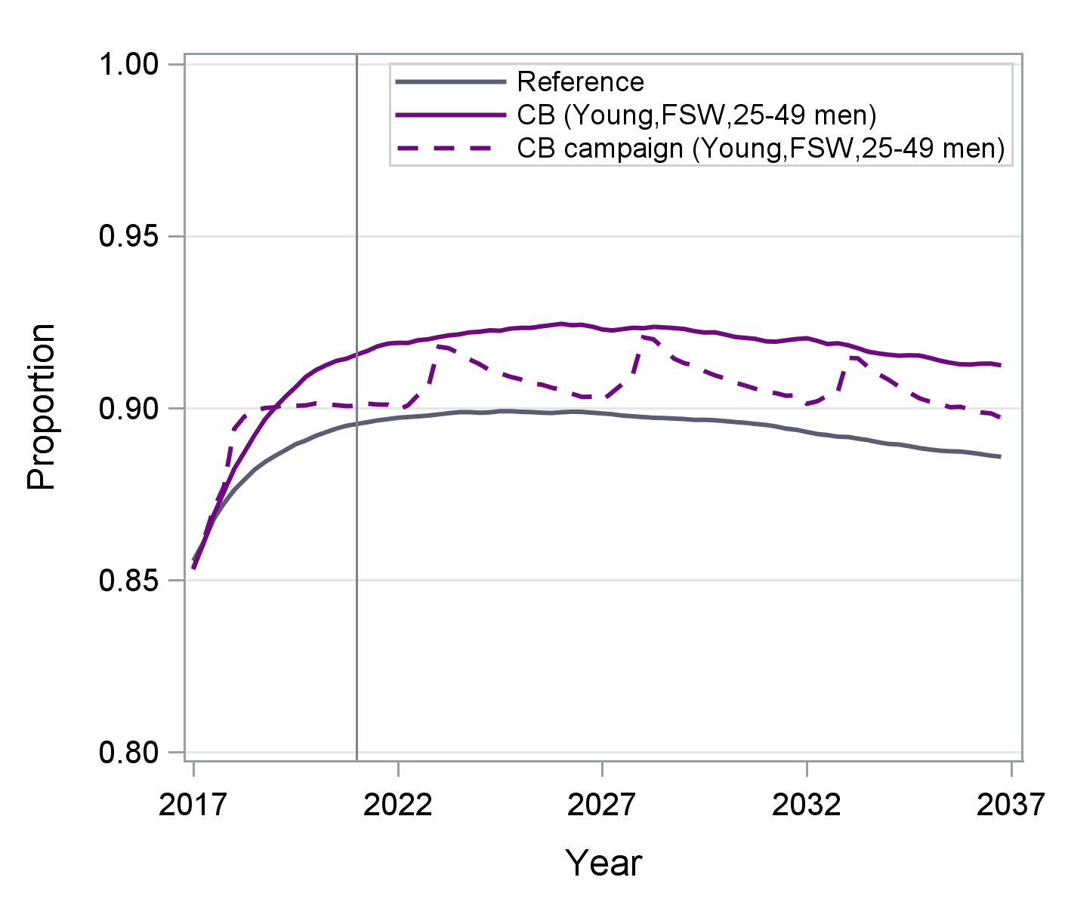
Trial Conclusions
Community-led HIVST can rapidly increase coverage, including men and adolescents
  Safe, effective, acceptable and desired
To maximise health impact of HIVST
  Door-to-door most reliable for local coverage
  Target high burden (undiagnosed/untreated HIV) communities or sub-groups with access to ART
Community-led approaches may give substantially better uptake, targeting and have additional benefits over CBD (STAR Phase 1 trials)
  “Better outcomes at similar or lower cost”
Policy makers could consider target communities
  Once-off or periodic (e.g. 5 yearly) campaigns
  Remote rural or urban slum communities with high undiagnosed HIV or to meet ”pent up demand”
HIVST to maintain 1st 90 in Zimbabwe
Indravudh PLoS Med 2021, Indravudh BMJ Glob Hlth 2021
Cambiano JIAS 2019 Slide courtesy of Valentina
Notes:
Malawi only

Slide 31
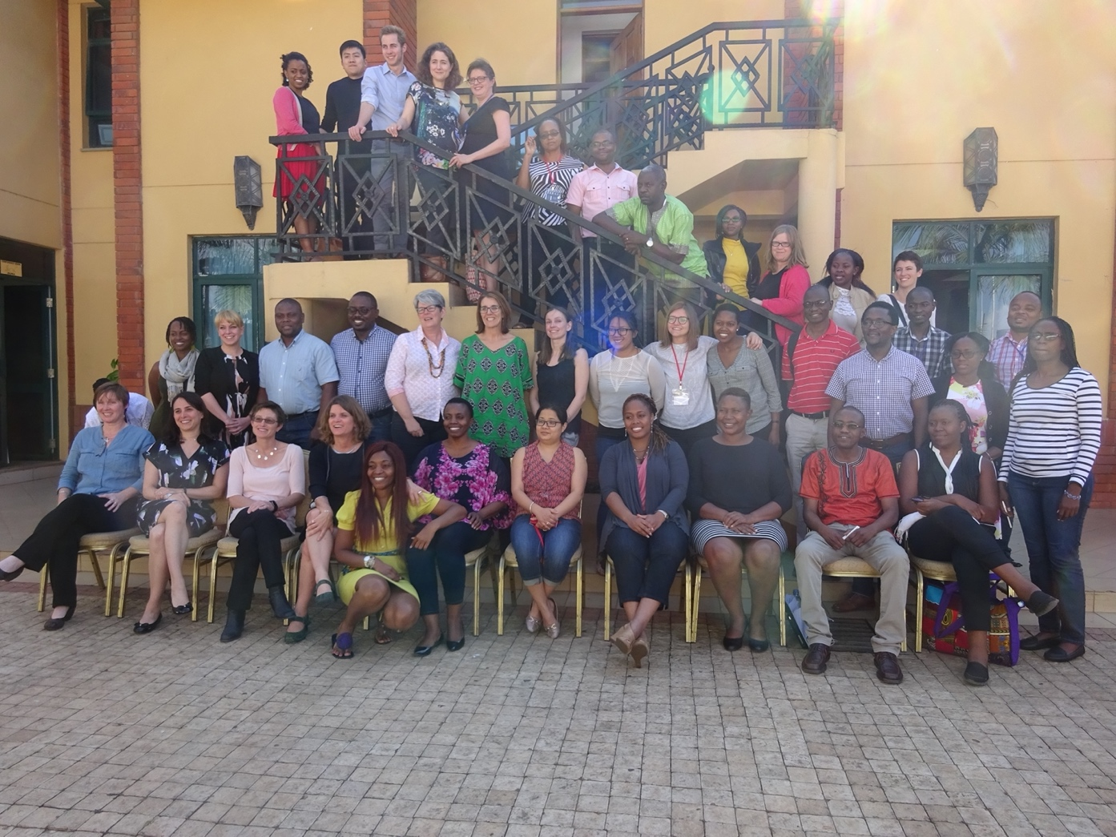

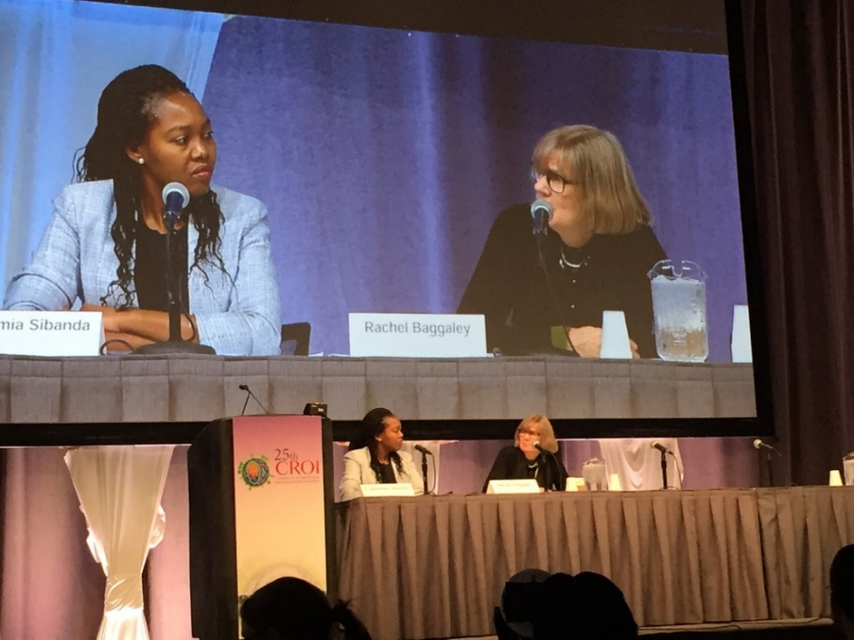
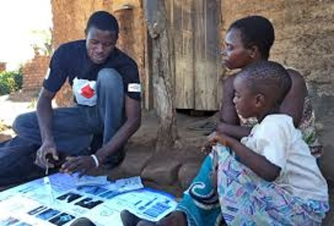

Harmonised research networks
London/Liverpool academic research consortium & network leads
Africa Research Institutes, PSI Country Offices, MOH: country protocols, implementation, impact evaluation. In-country researchers supported through regional workshops, country-visits and calls
Pop^{n} health & Epi
Social science
STAR Research meeting: Nairobi 2018
Economic
Math modelling
Key outputs
Publications – African 1st author on 28 of 63 STAR publications to date
Presentations – African presenter for 51 conference abstracts
Research Degrees – 4 African STAR PhDs using UK staff-studentship schemes
Research prizes - Euphemia Sibanda, Augustine Choko
Fellowships and research grants - African Principal Investigators x 3
South-South collaborations – African-led proposals EDCTP, UK-NIHR, Wellcome
Euphemia Sibanda
Presenter/Chair CROI 2019 with Rachael Baggaley
Website: http://Hivstar.lshtm.ac.uk and https://www.psi.org/project/star/

Slide 32

Acknowledgements
MLW and TB research teams
  Peter MacPherson, Helena Feasey, McEwen Khundi, Doris Shani
  London School – Katherine Fielding
STAR
  PSI and WHO - Karin Hatzold, Rachael Baggaley, Cheryl Johnson
  London School – Fern Terris-Prestholt, Katherine Fielding, Helen Ayles, Rosanna Peeling, Melissa Neuman, Pitchaya Indravudh, Linda Sande
  Liverpool School – Frances Cowan, Euphemia Sibanda
Researchers and implementers from Malawi, Zambia, Zimbabwe and South Africa
Economics Network
Quantitative and Epi Research Network
Qualitative Research Network
Communities, Ministries of Health and District Health teams
Website: http://Hivstar.lshtm.ac.uk
Augu Choko

