Slide 2
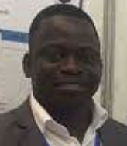
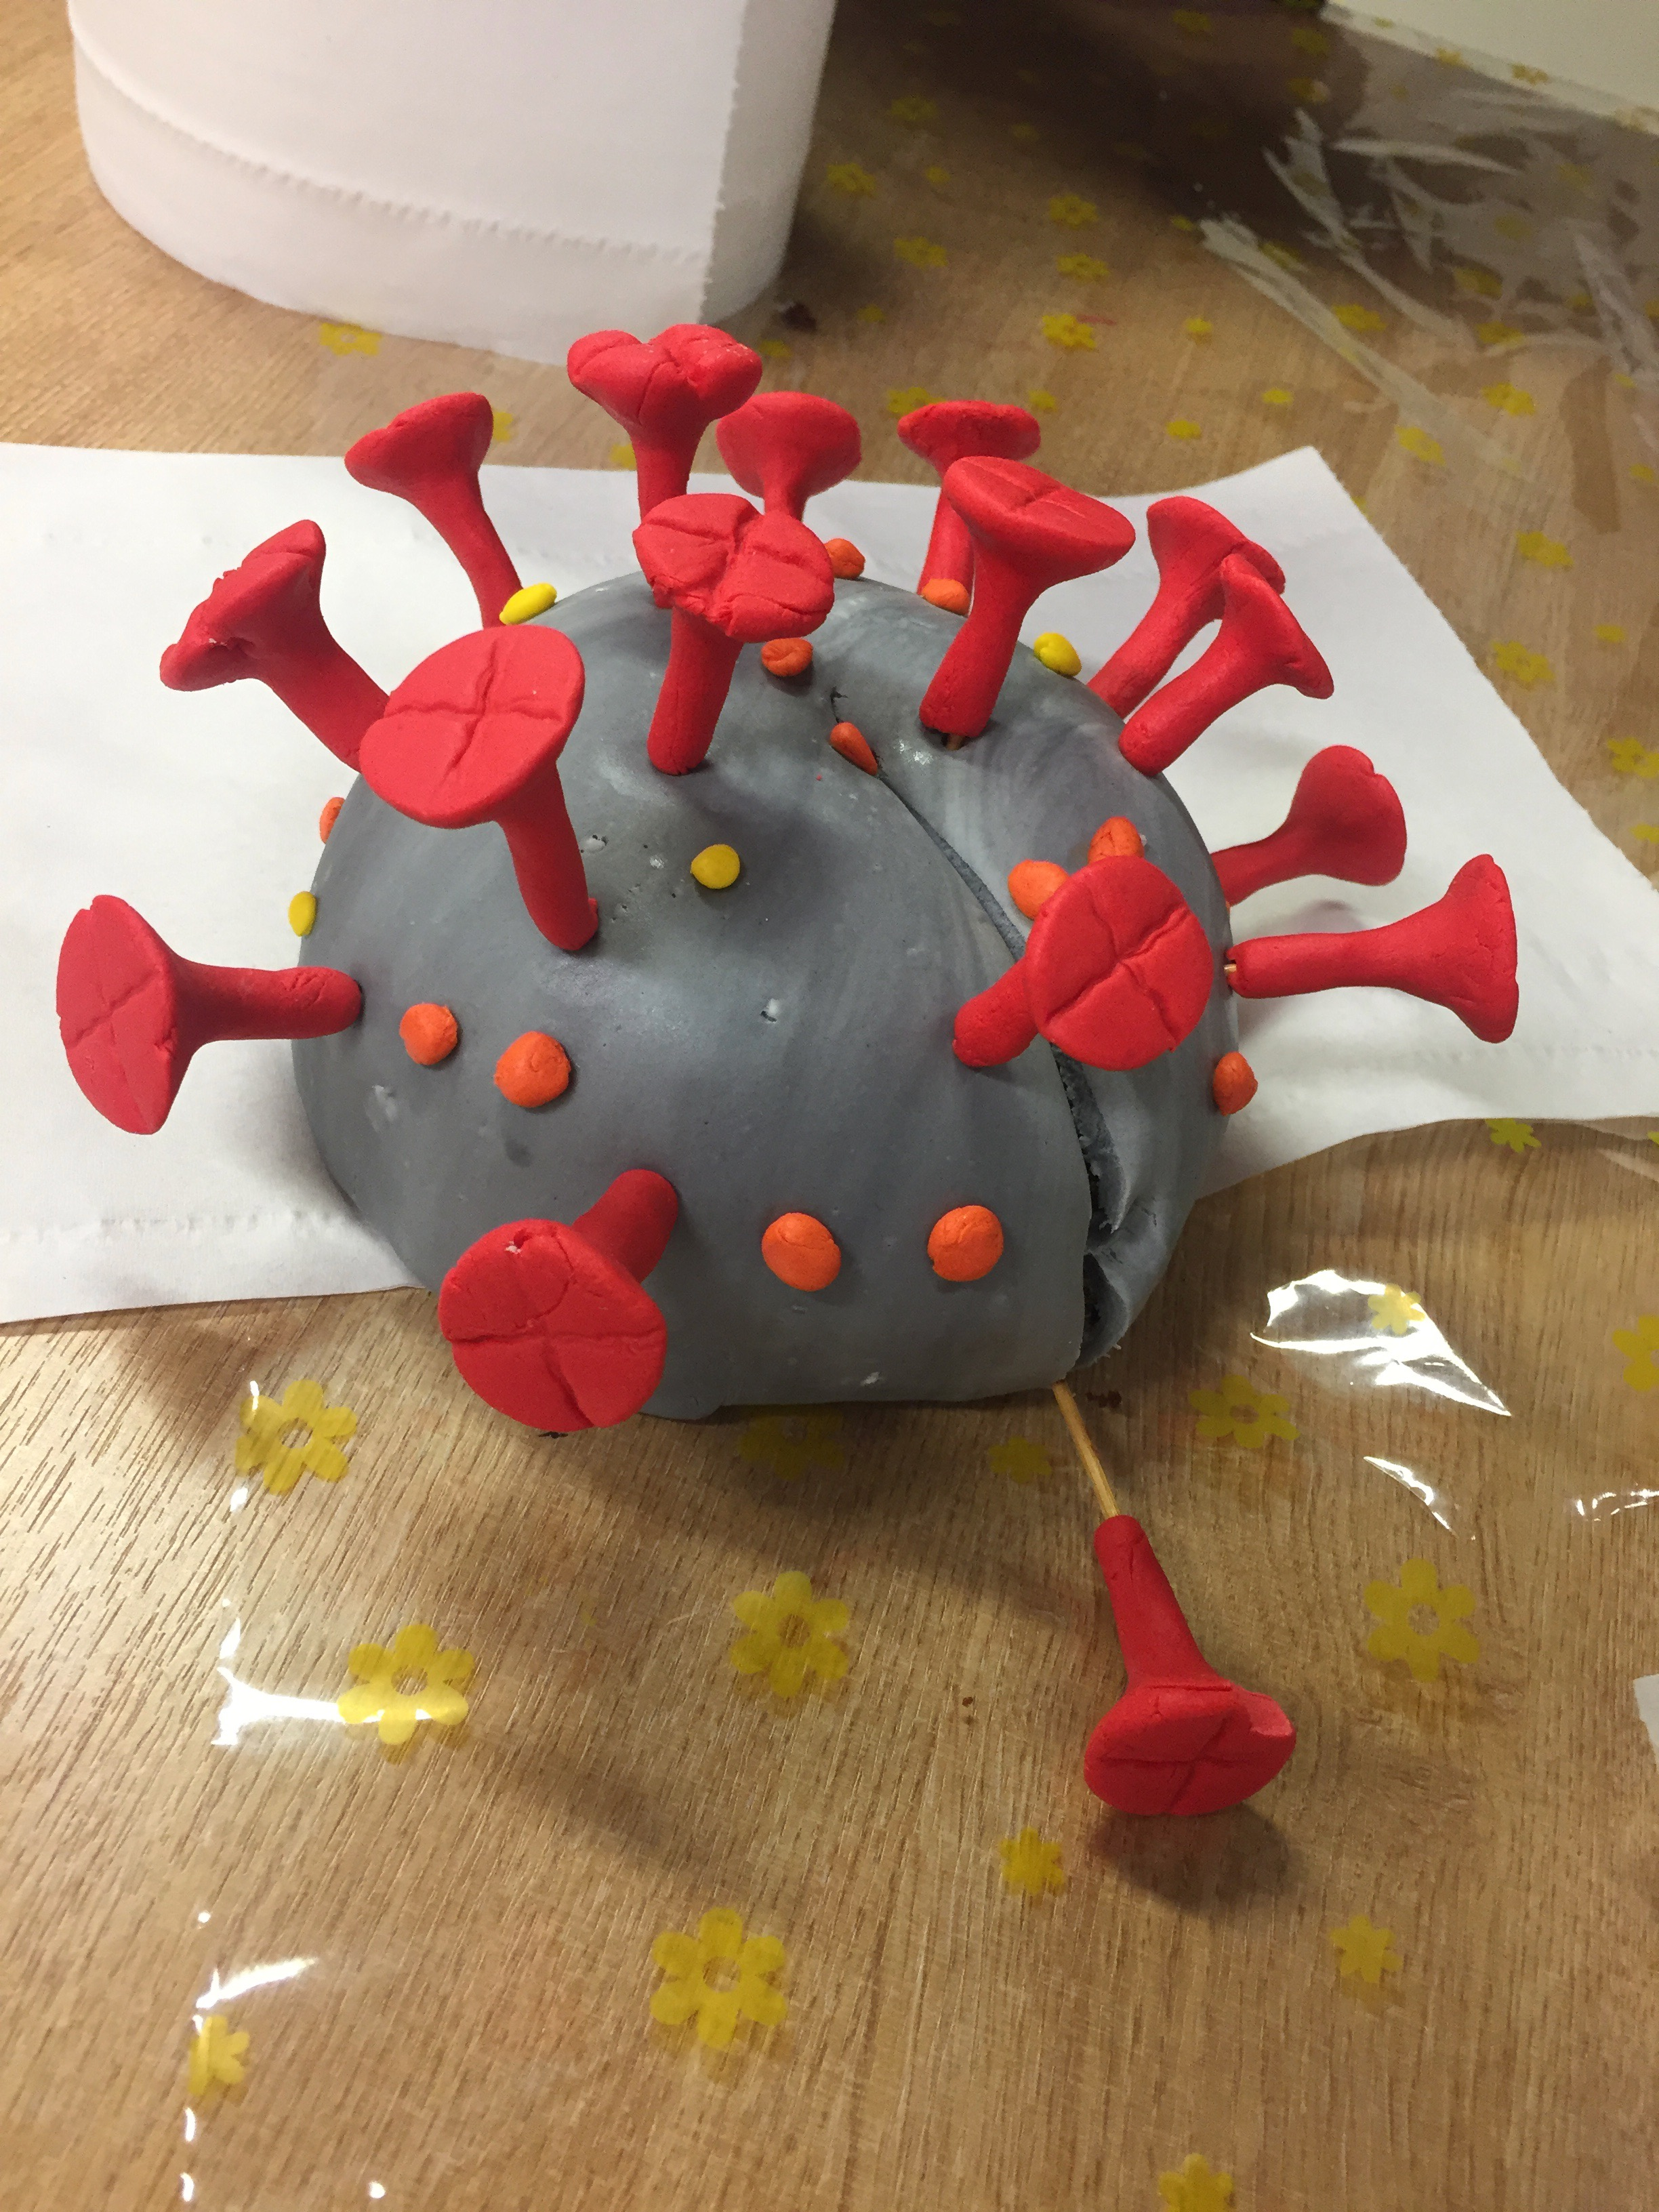
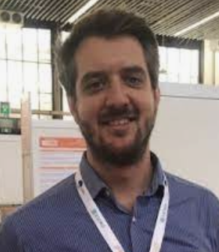
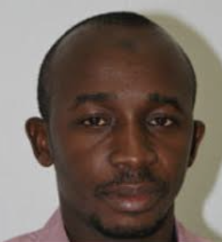
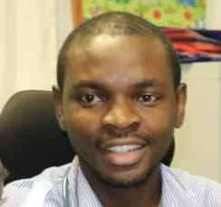
Research portfolio overview
COVID-19:
TransVir
ImmunoStaff
Epidemiology of ID post vaccine introduction
Immune ontogeny
Epidemiology of ID
Basic science
Pre-clinical
Phase 1
Phase 4
Phase 3
Phase 2
Systems
Vaccinology
biomarker-discovery
Malaria
Vaccine policy
Vaccine
confidence
TB Research program
TB
Pneumo
RSV
Meningo
Pneumo
Polio
Pertussis
HPV
MV
PcV
YF
Currently: 38 externally funded projects, total grant volume : over £ 25 Million

Slide 3
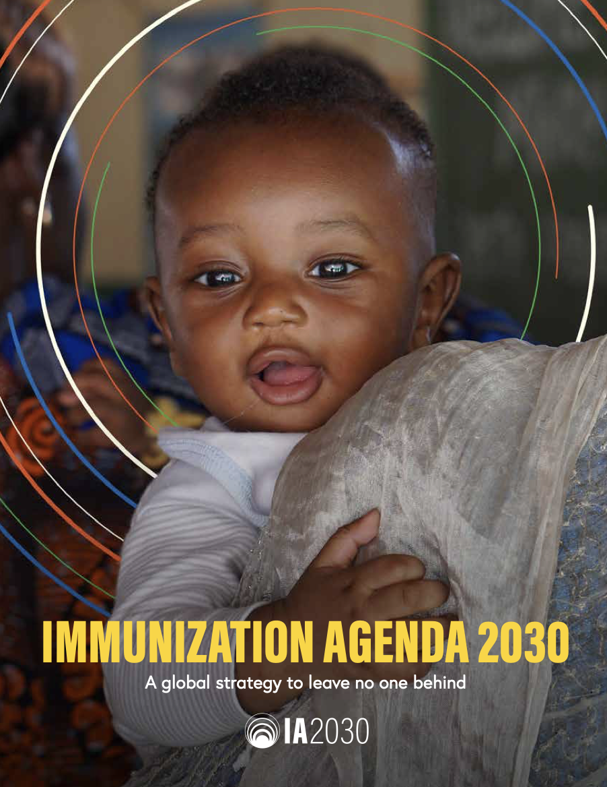
Over the last 5 years, we enrolled over 13,000 participants
into Phase I‐IV vaccine trials,
consistently achieving
follow up rates of above 95%
Funders:
UKRI/JGHT
NIH/BMGF
PATH
PATH
JGHT, Wellcome Trust
PATH

Slide 4
Theme Objectives
Delivery
Safety, immunogenicity, efficacy, policy
Strengthen evidence- based development
and delivery of vaccines across
all ages
Clinical Vaccine trials
Optimising
host
responses
Potential
Impact of a
given vaccine
Host/pathogen
interactions
Host responses
Pathogen detection
Discovery
Understanding immune responses to optimize
vaccine design and development

Slide 5
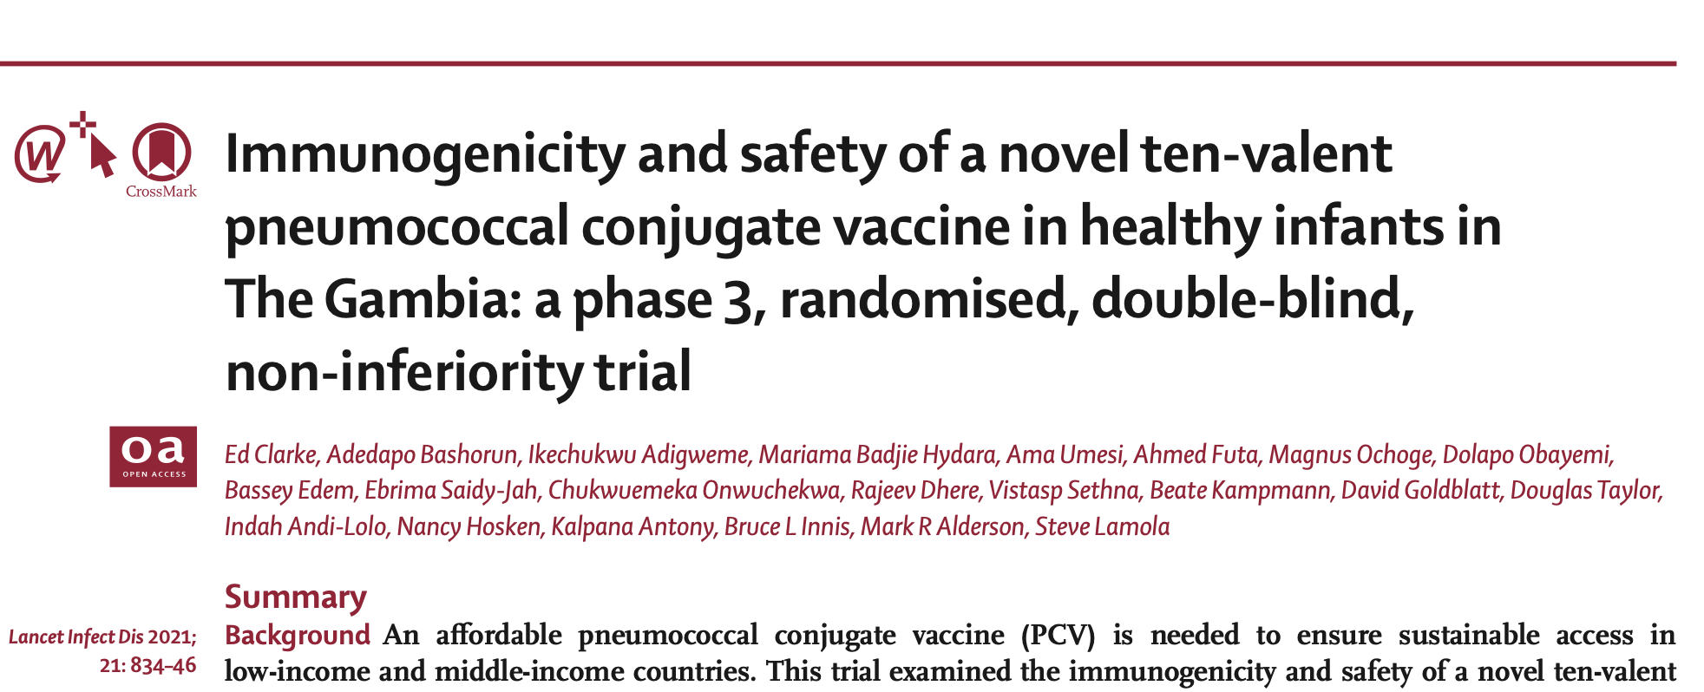
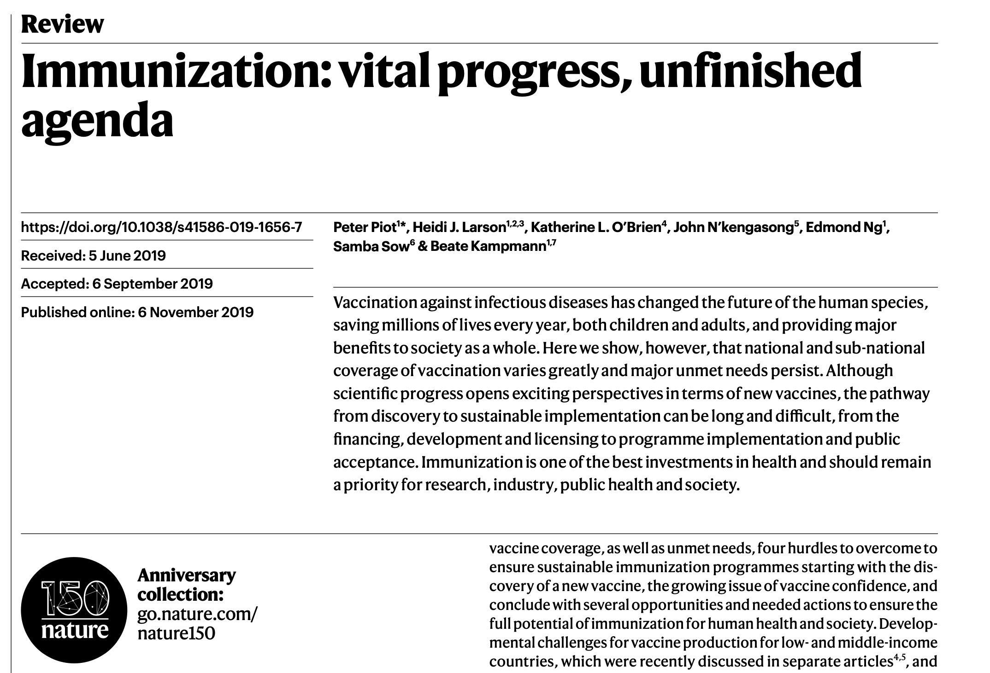
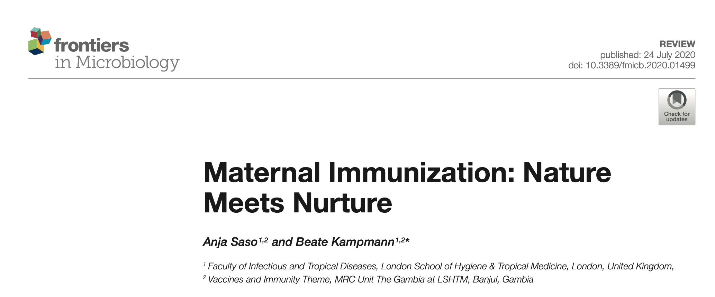
Policy Impact of recent vaccine trials and advocacy
Lancet Glob Health 2016; 4: e534–47

Slide 6
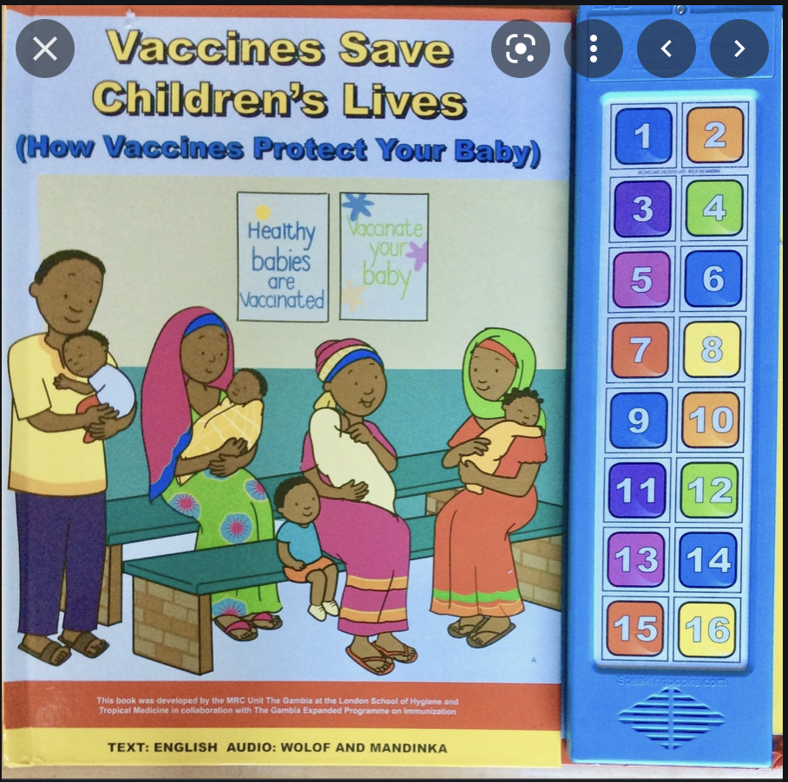
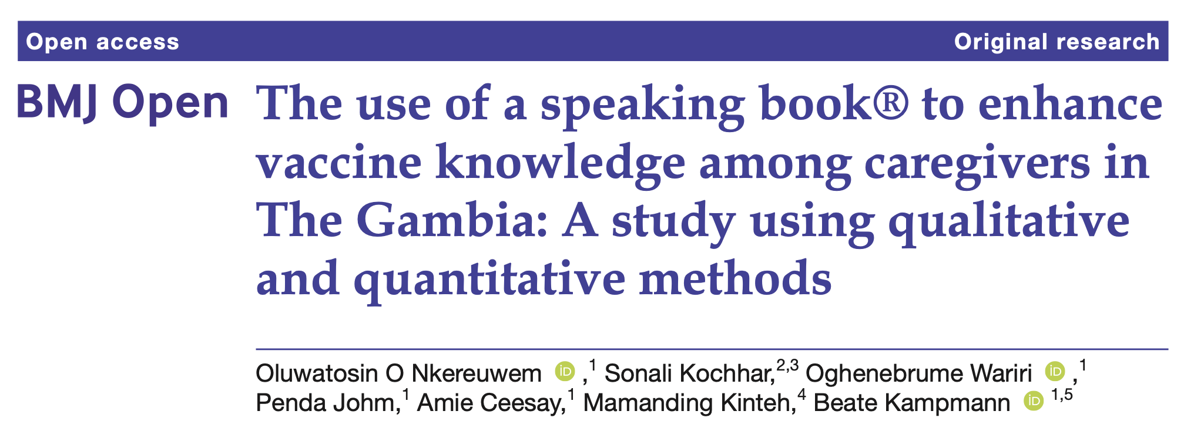
Hib vaccine 1997
What matters is getting safe and effective vaccines to those who need them:
The Gambia’s EPI: partnership with MRCG
Hepatitis B Vaccine 1986
Vaccines across the ages
HPV
COVID-19
Vaccines in pregnancy
Prevnar 2009:
2nd country in Africa
PCV-13 2011
MenAfriVac 2013
Rotavirus 2013
BMJ Open 2021;11:e040507
HPV 2015

Slide 7
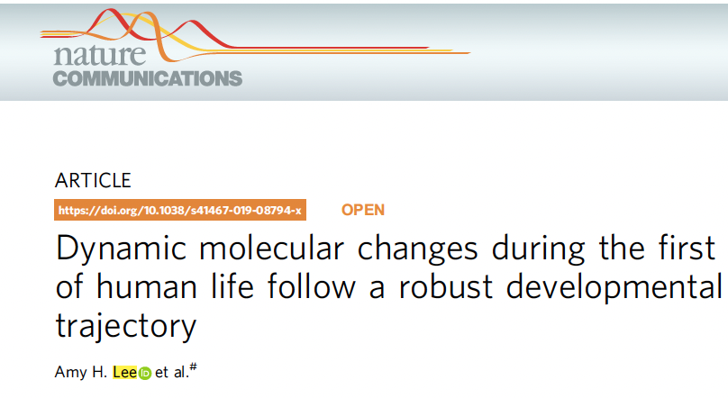
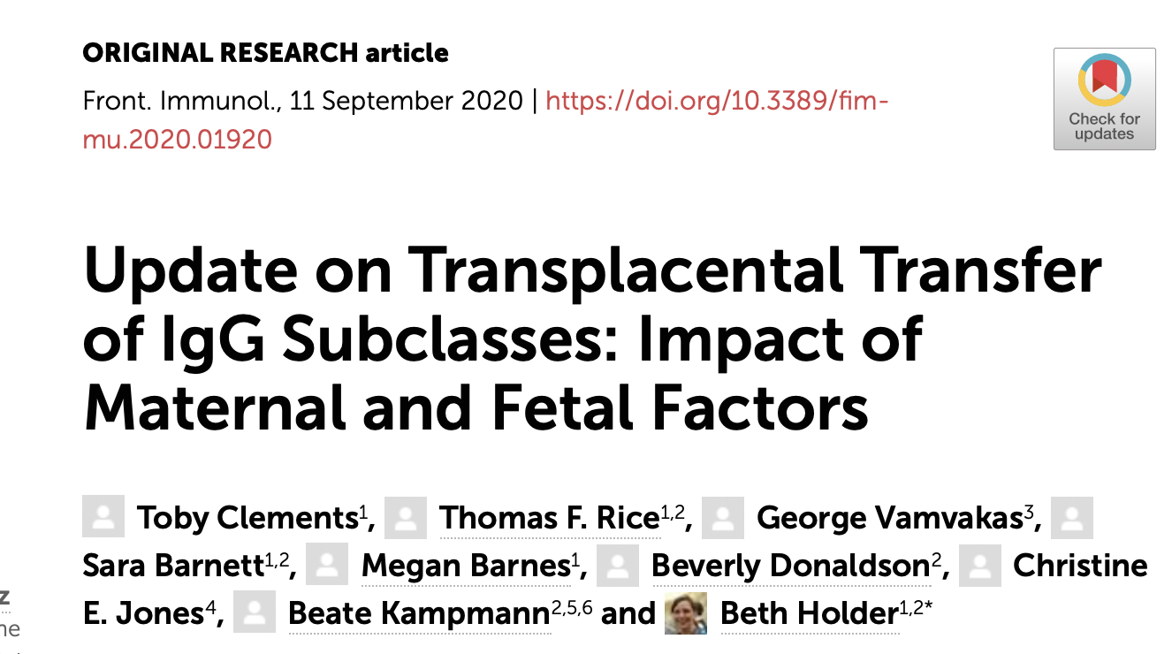
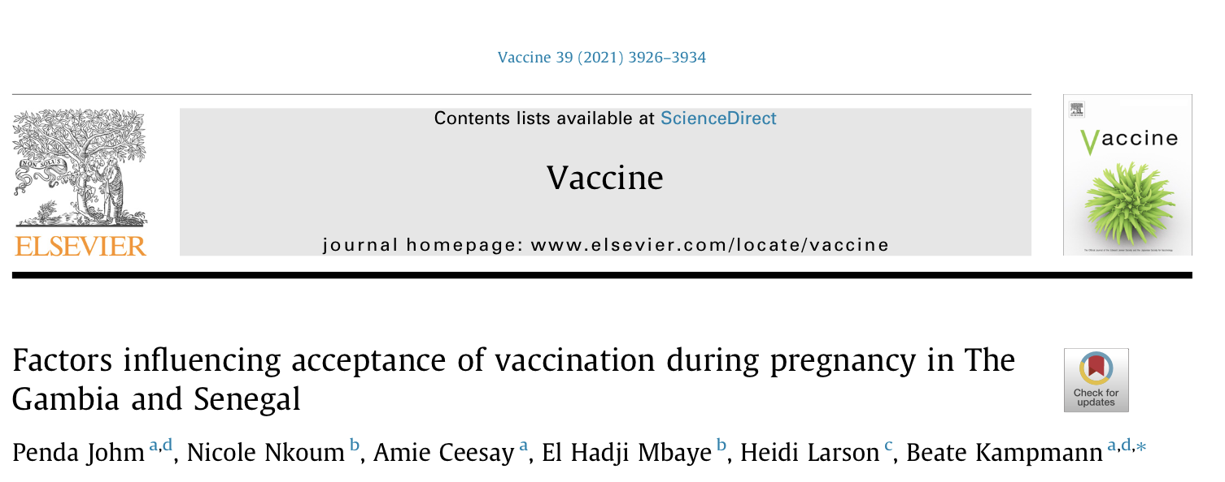
Vaccines in Pregnancy as a strategy to prevent maternal & neonatal mortality – building a platform to safely conduct clinical trials and discovery science
Immune ontogeny
Placental biology
Safe and effective vaccines for use in pregnant women
RSV
Clinical Trials
Vaccine acceptancy:
Qualitative science
MenA, Pneumo (Propel)

Slide 8
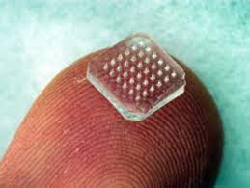
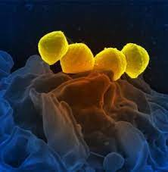
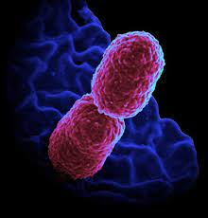
Looking ahead:
Vaccines are for life: Life‐course approach to vaccination- HPV, COVID, others
Including in pregnancy: GBS, RSV, plus vaccines for emerging pathogens, e.g. COVID
Optimising vaccines, schedules, delivery against key pathogens affecting the health of women and
Children (e.g. micro-needle devices, yellow-fever boosters)
Setting the scene: Epidemiology of Group A Streptococcus (GAS) in anticipation of GAS vaccine candidates
becoming available in the next few years (e.g. GAS genomics, transmission dynamics); Klebsiella and AMR
Vaccine confidence, including working with NRA to improve AEFI reporting

Slide 9
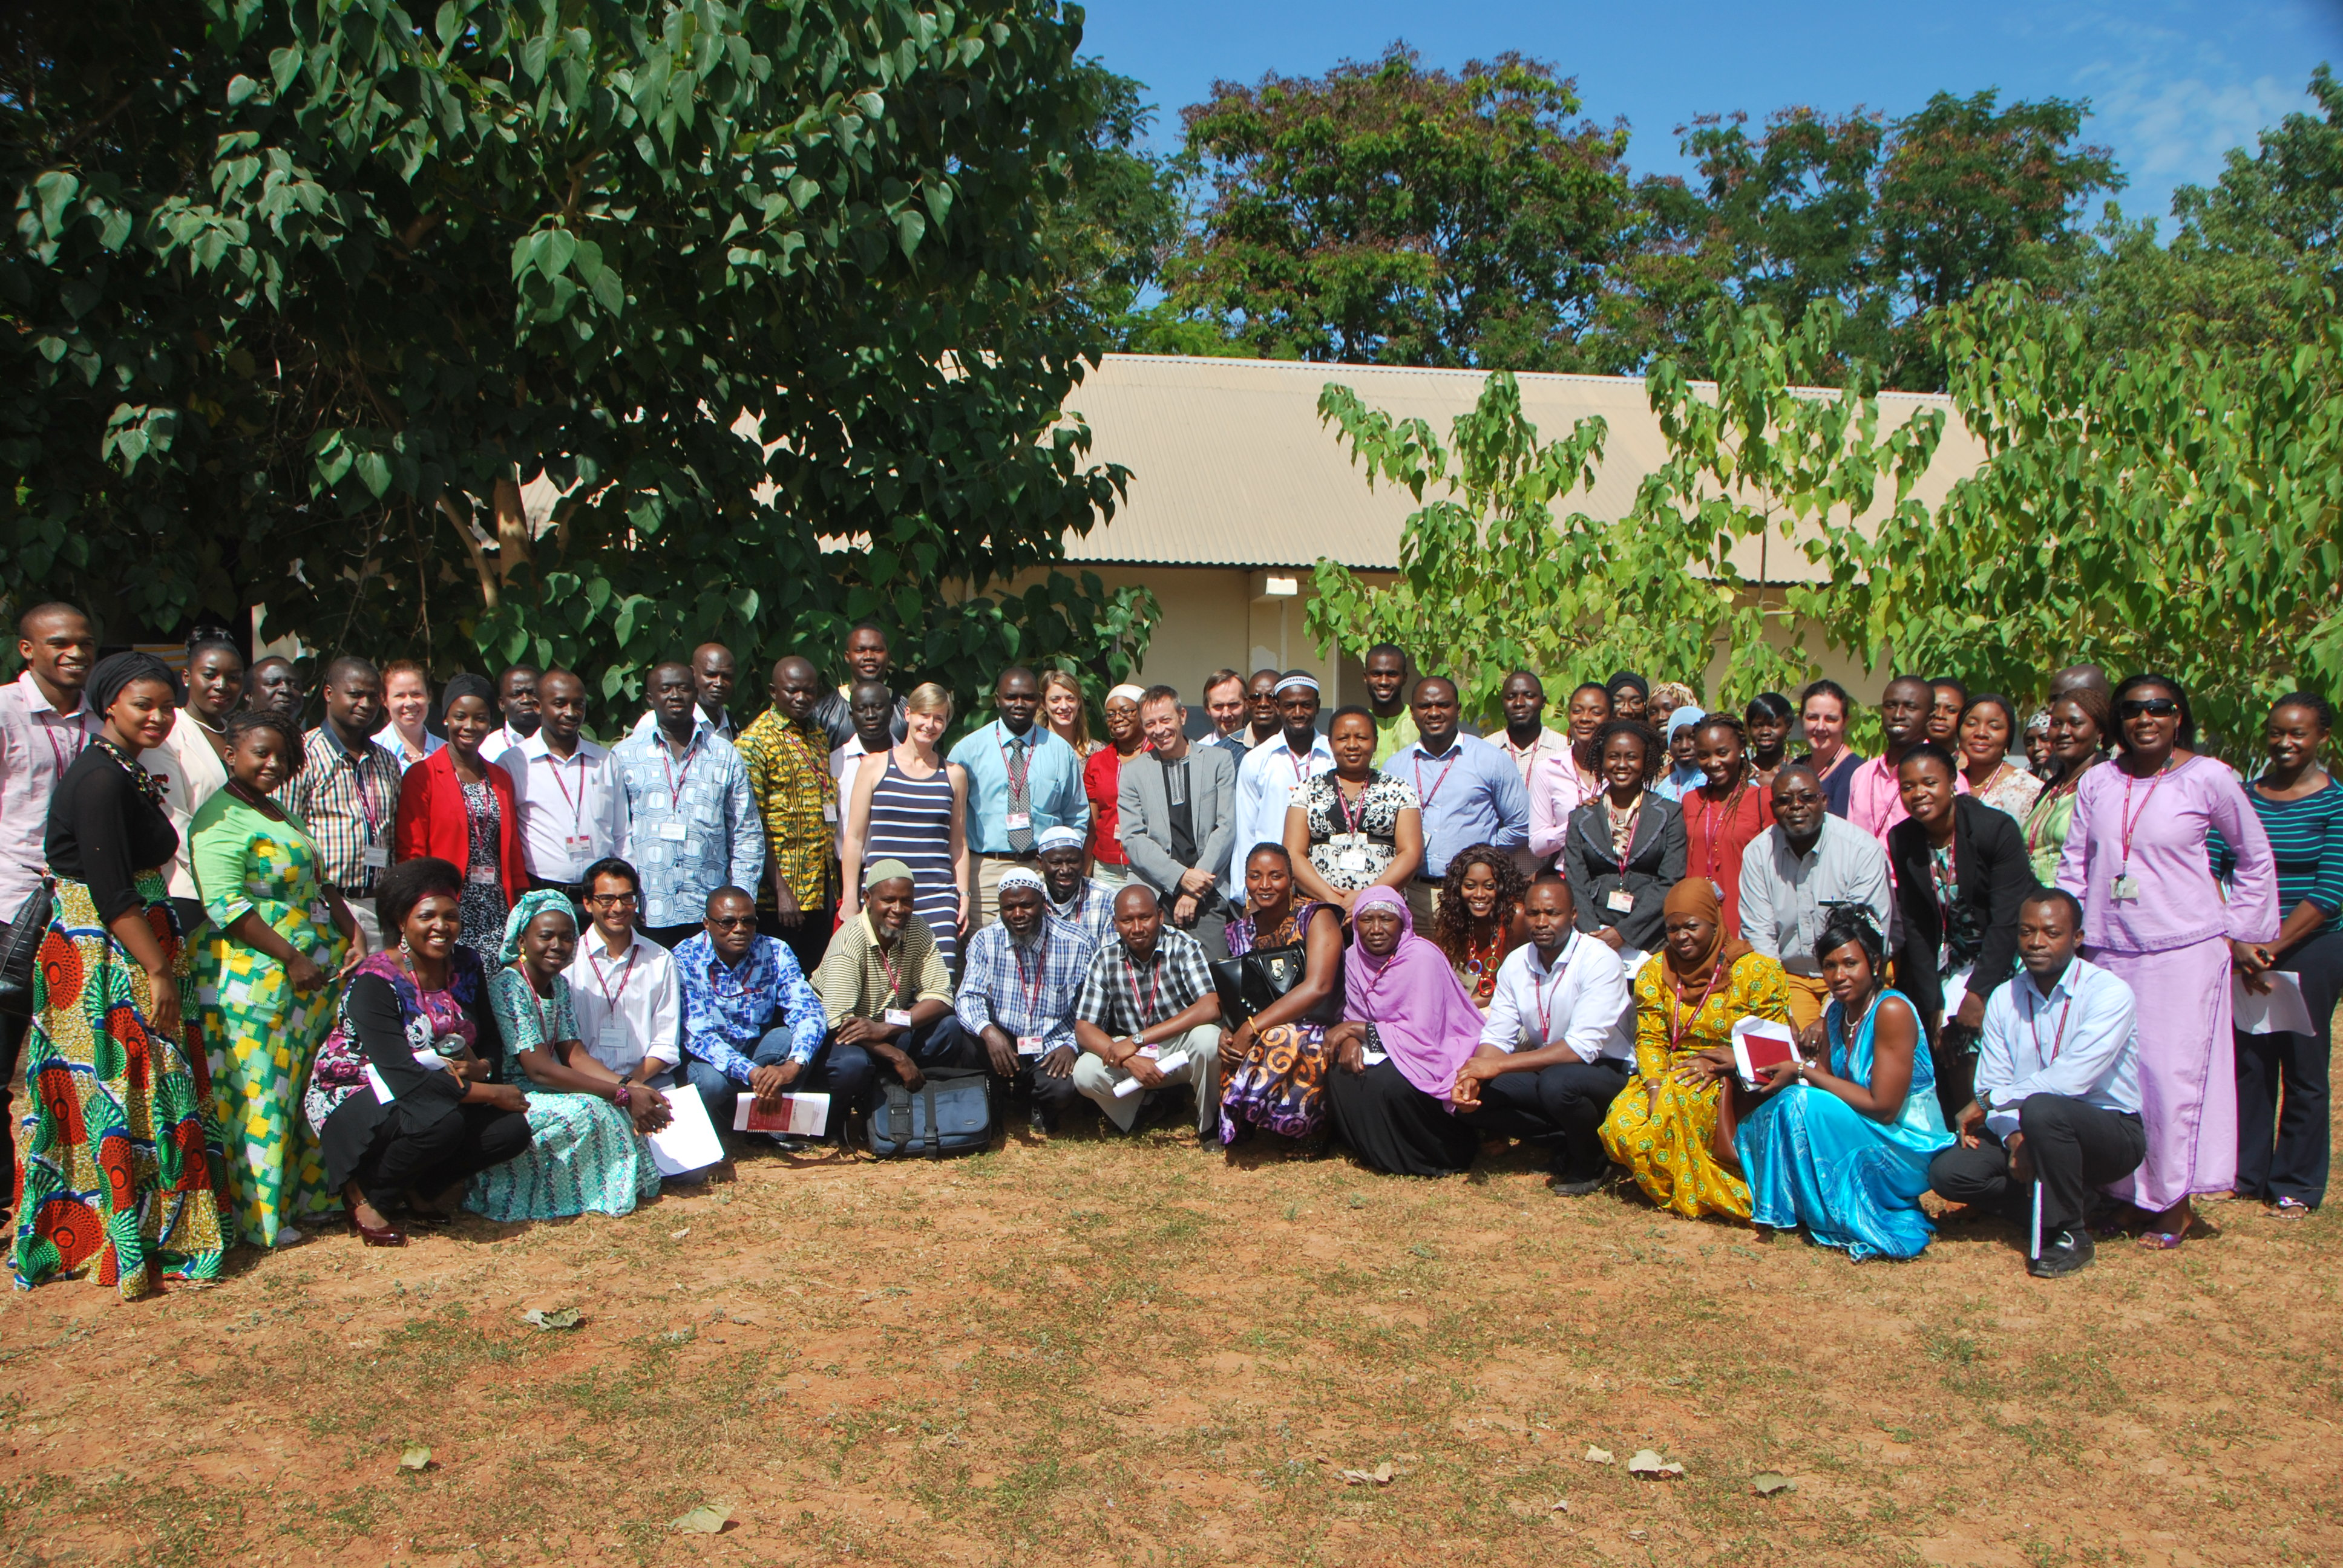
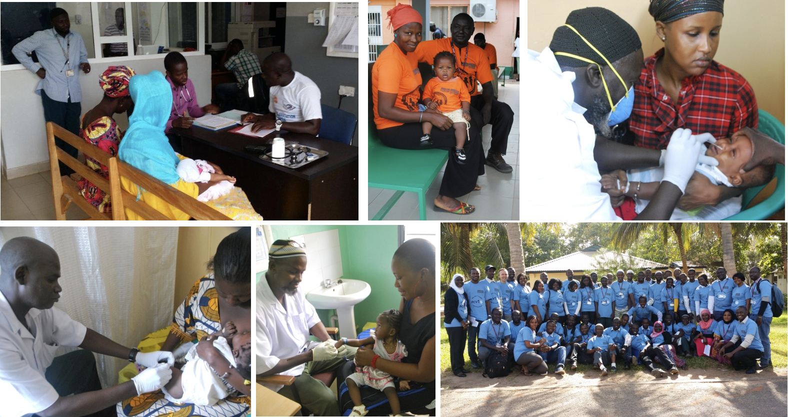
Thank you to the fabulous teams in field, labs, data and clinic
Welcome to the MRC Unit and our vaccine science-
please just find me during the week if you wish to know more about specific projects

