Slide 1

Clinical and immunological outcomes of
children with antenatal HIV and CMV exposure
Ceri Evans

Slide 2
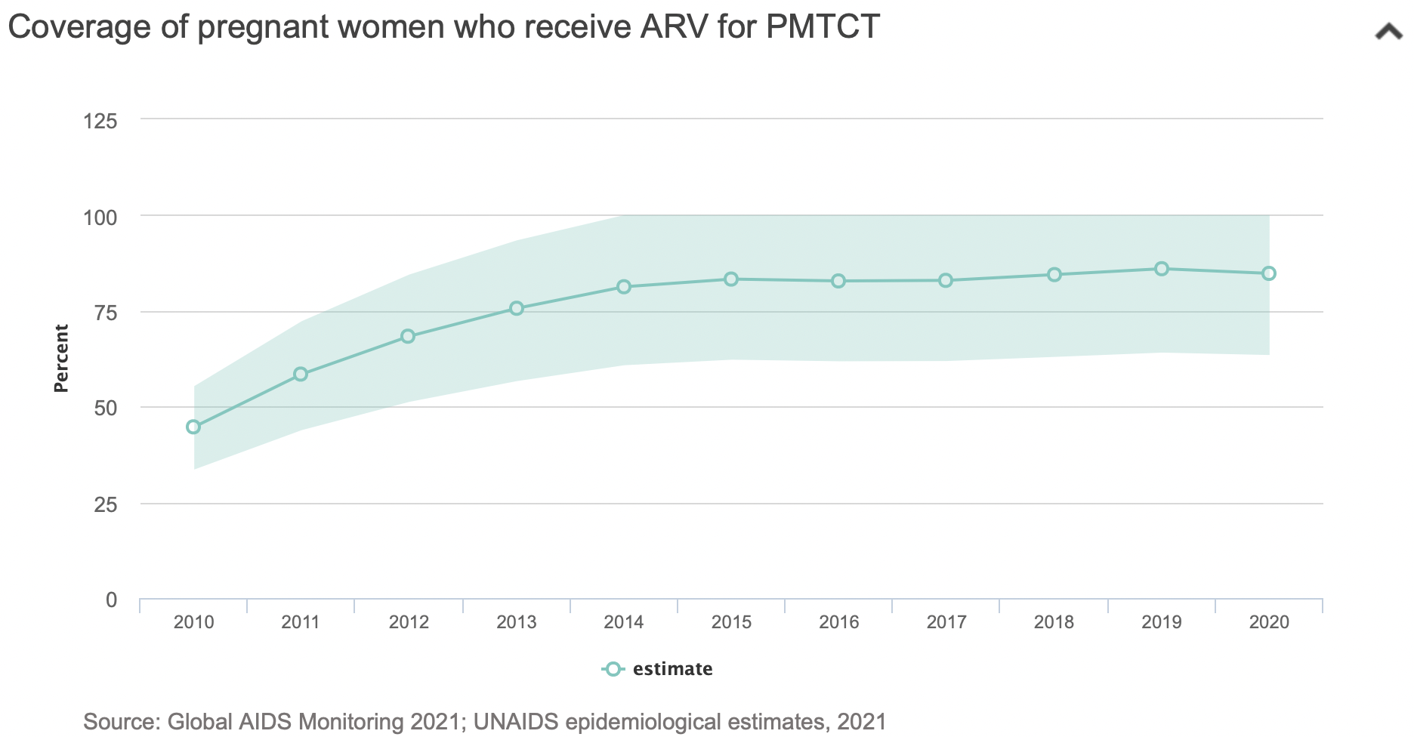
Reduction in vertical HIV transmission
Overall outcomes of children born to mothers living with HIV remain poor
Increased mortality, particularly in early life – before infant interventions

Slide 3
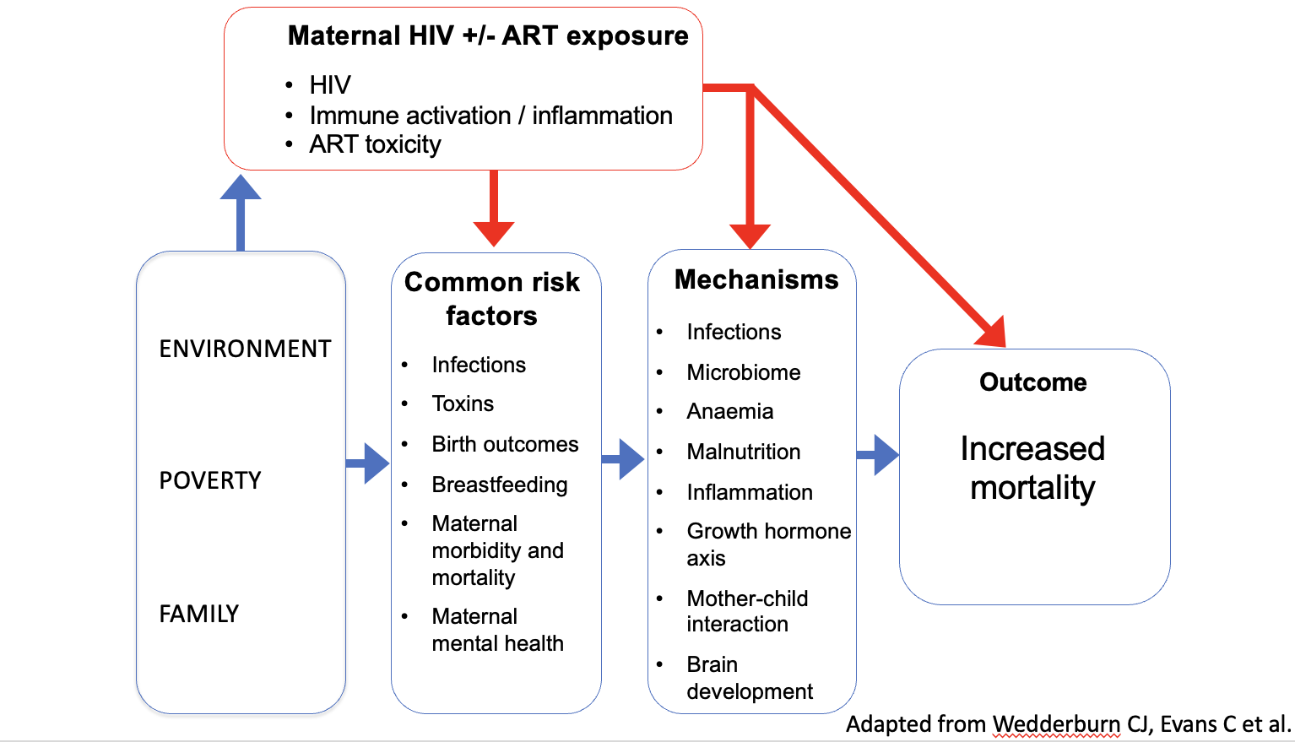
Biological or sociodemographic drivers?

Slide 4
Question 1. What are the HIV-associated maternal drivers of infant mortality?
HIV
Co-infections
Inflammation

Slide 5
Question 1. What are the HIV-associated maternal drivers of infant mortality?
HIV
Co-infections
Inflammation
738 children
Maternal plasma from second trimester of pregnancy
Understand the underlying pathways
Antenatal identification of infants most at risk

Slide 6
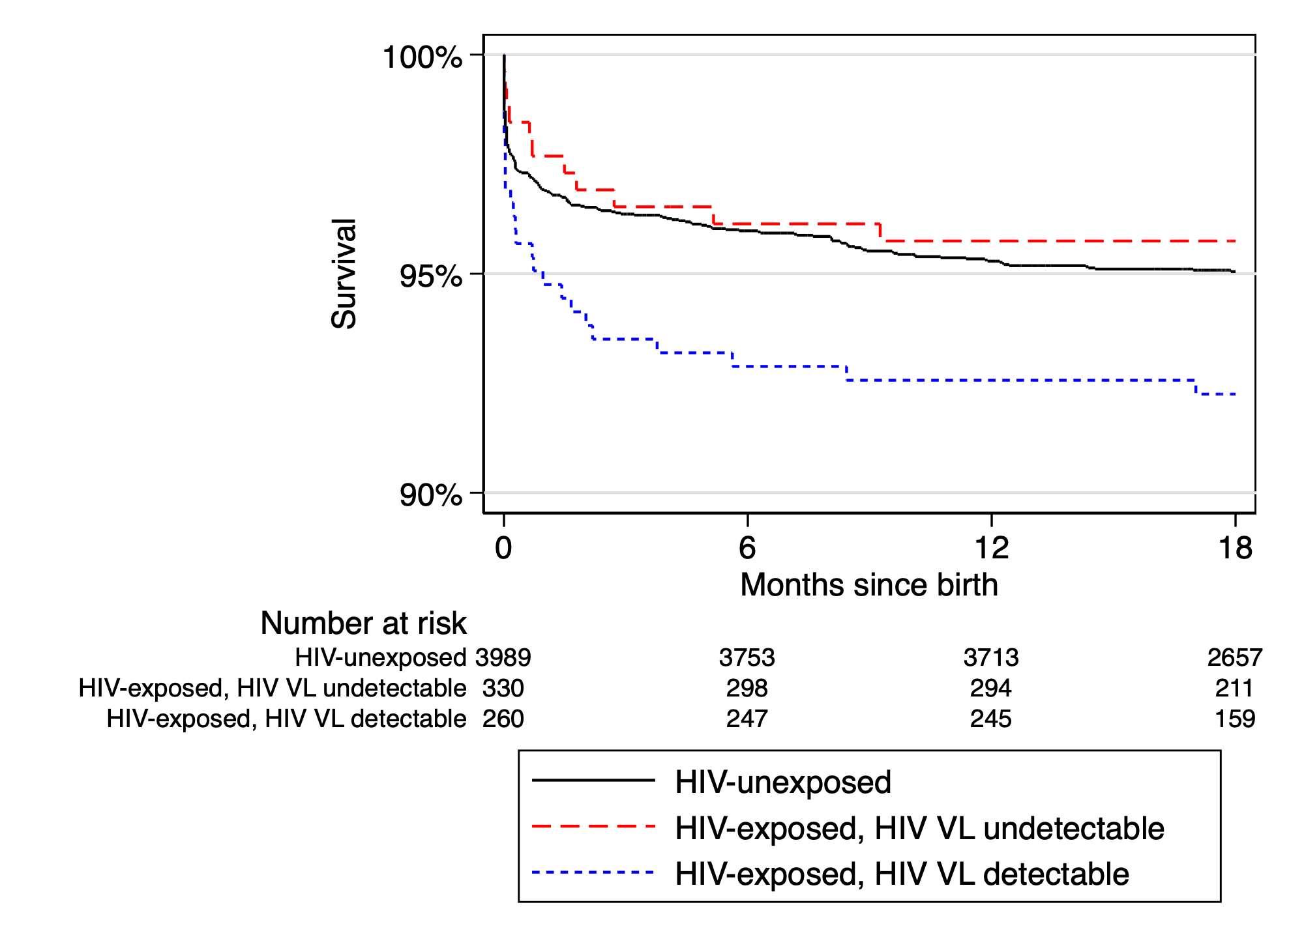
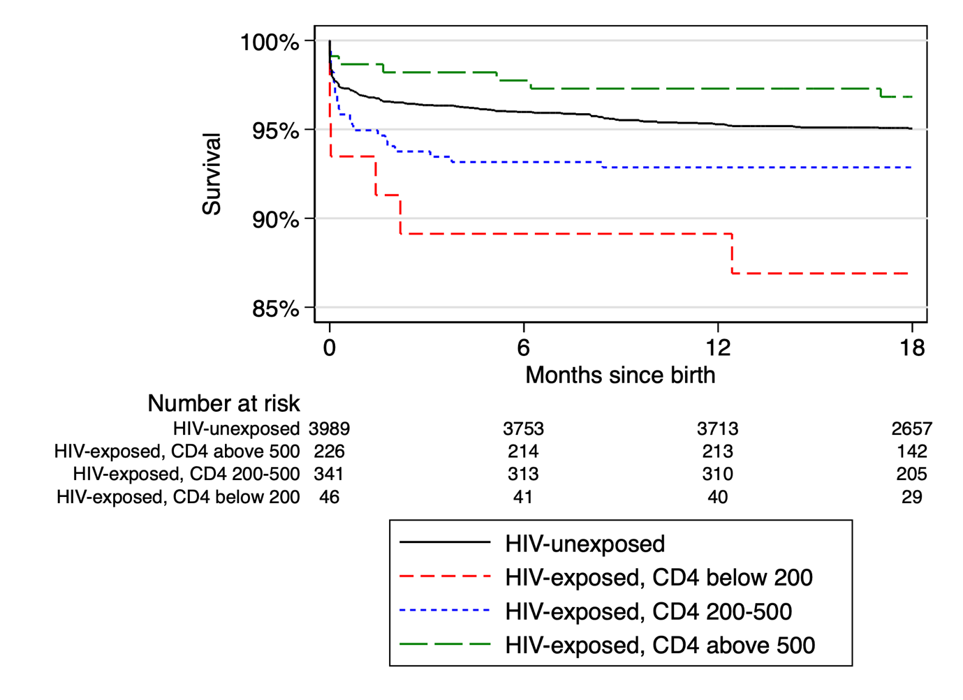
Maternal HIV viral load and CD4 count

Slide 7
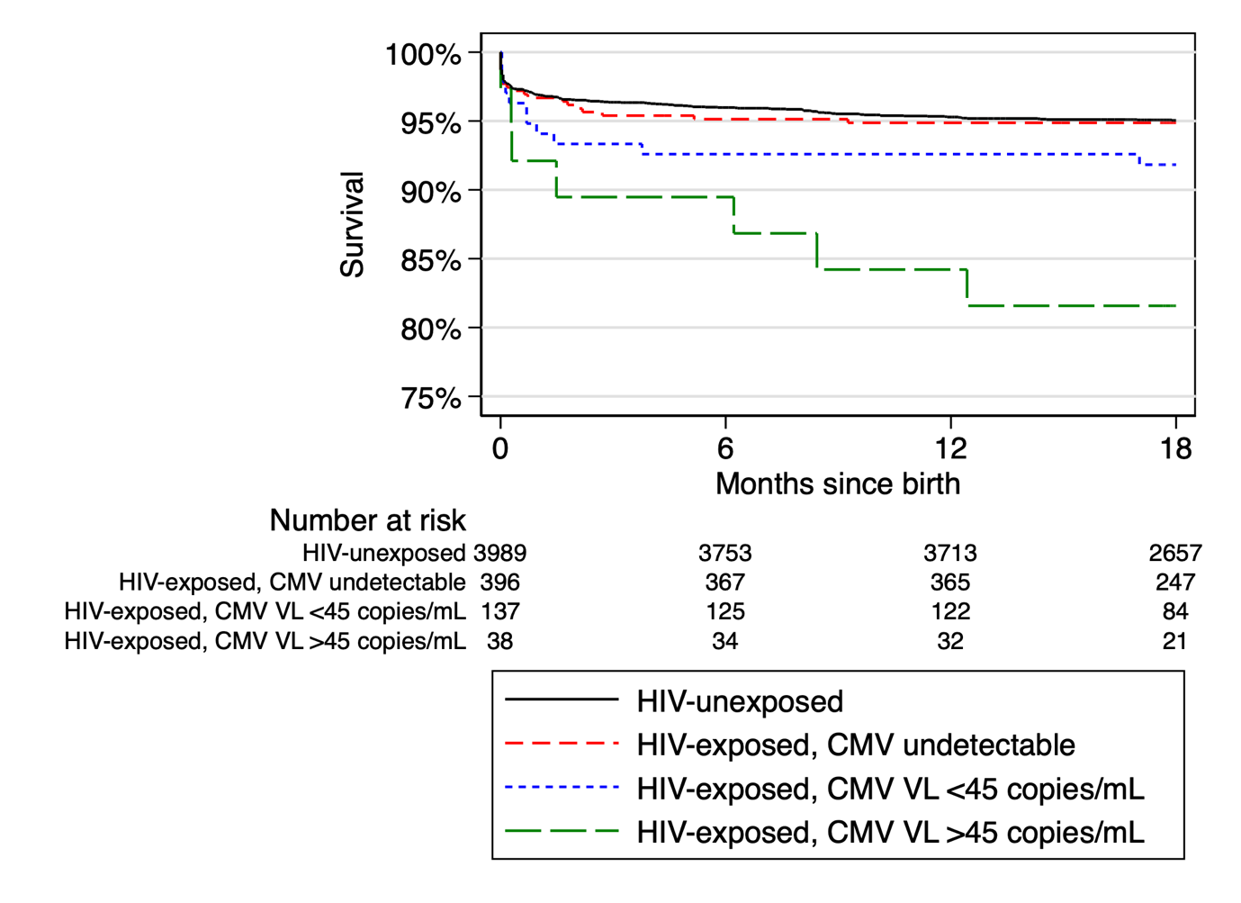
Maternal CMV co-infection
31% of women CMV viraemic in
second trimester
Antenatal cytomegalovirus viraemia | Infant mortality, n/N (%) | Adjusted hazard ratio* | P
Undetectable | 20/396 (5.1%) | Reference
Detectable <45 copies/mL | 12/137 (8.8%) | 1.69 (0.82, 3.49) | 0.155
>45 copies/mL | 8/38 (21.1%) | 3.32 (1.43, 7.72) | 0.005

Slide 8
Maternal inflammation
 | Adjusted hazard ratio per log rise in CRP* | P
HIV-exposed | 2.09 (1.33, 3.27) | 0.001
*Adjusted for maternal HIV viral load, CD4 count, CMV co-infection,
gestational age at blood sampling and randomised trial arm.

Slide 9
Maternal inflammation
 | Adjusted hazard ratio per log rise in CRP* | P
HIV-exposed | 2.09 (1.33, 3.27) | 0.001
HIV-unexposed | 1.69 (0.82, 3.49) | 0.155
*Adjusted for maternal HIV viral load, CD4 count, CMV co-infection,
gestational age at blood sampling and randomised trial arm.

Slide 10
Question 2. Are there immunological abnormalities?
143 HIV-exposed uninfected (HEU) children vs. 143 HIV-unexposed children
Plasma and cells from 1 month of age

Slide 11
Question 2. Are there immunological abnormalities?
143 HIV-exposed uninfected (HEU) children vs. 143 HIV-unexposed children
Plasma and cells from 1 month of age
Immune activation
  T-cell activation markers (CD38, HLA-DR)
  T-cell proliferation (Ki67)
  T-cell differentiation (CD45-RA, CD27)
  T-cell senescence (CD28, CD57)
  T-cell exhaustion (PD-1)
  Monocyte subsets (CD14, CD16)
  Soluble CD14, soluble CD163, CRP, IL-6

Slide 12
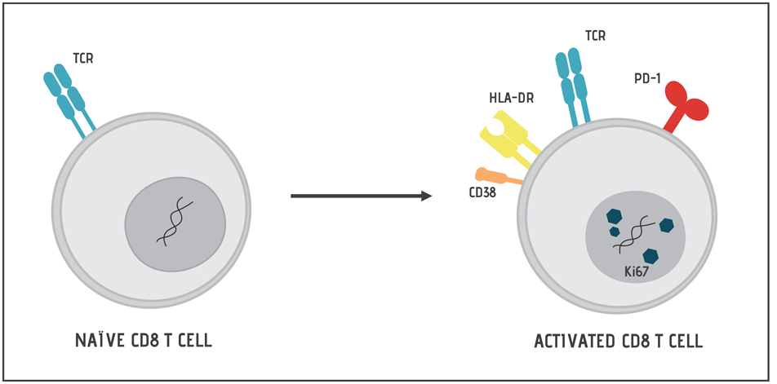
Carlisle et al., 2020

Slide 13
Carlisle et al., 2020
Larbi and Fulop, 2014

Slide 15
CD8⁺ T-cell activation and proliferation

Slide 16
CD8⁺ T-cell differentiation

Slide 17
CD8⁺ T-cell senescence and exhaustion

Slide 18
Monocyte cell subsets

Slide 19
Soluble CD14

Slide 20
Question 3. What are the drivers of infant immune activation
Maternal HIV viral load
Maternal CMV viraemia
Early infant CMV acquisition

Slide 21
Maternal HIV viral load and infant CD8⁺ cells
 | Adjusted* coefficient (95%CI) | P
Naïve CD8⁺ T-cells | -0.12 (-0.29, 0.06) | 0.187
Central memory CD8⁺ T-cells | 0.11 (-0.05, 0.28) | 0.182
Effector memory CD8⁺ T-cells | 0.03 (-0.12, 0.19) | 0.697
TEMRA CD8⁺ T-cells | 0.08 (-0.03, 0.19) | 0.166
CD28⁺ CD57⁻ CD8⁺ T-cells | -0.13 (-0.28, 0.10) | 0.068
CD28⁻ CD57⁺ CD8⁺ T-cells | 0.17 (0.04, 0.29) | 0.010
PD-1⁺ CD8⁺ T-cells | 0.11 (-0.02, 0.23) | 0.096
CD38⁺ HLA-DR⁺ CD8⁺ T-cells | 0.12 (-0.05, 0.29) | 0.167
Ki67⁺ CD8⁺ T-cells | 0.06 (-0.13, 0.24) | 0.557

Slide 22
Maternal CMV viraemia and infant CD8⁺ cells
Women living with HIV more likely to have CMV viraemia in pregnancy (31% vs. 13%)

Slide 23
Strong differences in CD8⁺ T-cell activation in HEU children with and without CMV exposure
 | Mean percentage (95%CI)
 | Detectable CMV viraemia (N=20) | Undetectable CMV viraemia (N=65) | Adjusted* coefficient (95%CI) | P
Naïve CD8⁺ T-cells | 73.91 (60.85, 86.96) | 86.35 (81.22, 91.47) | -0.60 (-1.07, -0.14) | 0.011
Central memory CD8⁺ T-cells | 12.93 (6.69, 19.17) | 8.81 (5.27, 12.36) | 0.27 (-0.08, 0.61) | 0.135
Effector memory CD8⁺ T-cells | 5.16 (1.37, 8.96) | 1.64 (0.43, 2.86) | 0.62 (0.16, 1.07) | 0.008
TEMRA CD8⁺ T-cells | 8.01 (2.16, 13.86) | 3.19 (1.30, 5.08) | 0.67 (0.21, 1.12) | 0.004
CD28⁺ CD57⁻ CD8⁺ T-cells | 74.46 (63.33, 85.58) | 86.66 (82.31, 91.01) | -0.57 (-0.96, -0.18) | 0.004
CD28⁻ CD57⁺ CD8⁺ T-cells | 14.13 (6.34, 21.92) | 4.06 (1.85, 6.27) | 0.85 (0.44, 1.27) | <0.001
PD-1⁺ CD8⁺ T-cells | 11.15 (4.30, 18.00) | 4.65 (2.38, 6.91) | 0.68 (0.29, 1.08) | 0.001
CD38⁺ HLA-DR⁺ CD8⁺ T-cells | 14.92 (8.24, 21.60) | 11.05 (6.90, 15.21) | 0.32 (-0.05, 0.68) | 0.089
Ki67⁺ CD8⁺ T-cells | 16.79 (8.04, 25.55) | 14.95 (9.61, 20.29) | 0.10 (-0.32, 0.53) | 0.631

Slide 24
Little difference in CD8⁺ T-cell activation in HIV-unexposed children with and without CMV exposure
 | Adjusted* coefficient (95%CI) | P
Naïve CD8⁺ T-cells | -0.21 (-0.64, 0.22) | 0.346
Central memory CD8⁺ T-cells | 0.15 (-0.27, 0.56) | 0.484
Effector memory CD8⁺ T-cells | 0.22 (-0.23, 0.67) | 0.342
TEMRA CD8⁺ T-cells | 0.21 (-0.24, 0.66) | 0.361
CD28⁺ CD57⁻ CD8⁺ T-cells | -0.17 (-0.60, 0.25) | 0.429
CD28⁻ CD57⁺ CD8⁺ T-cells | -0.01 (-0.42, 0.39) | 0.952
PD-1⁺ CD8⁺ T-cells | -0.01 (-0.43, -0.42) | 0.975
CD38⁺ HLA-DR⁺ CD8⁺ T-cells | 0.19 (-0.29, 0.68) | 0.436
Ki67⁺ CD8⁺ T-cells | 0.43 (-0.03, 0.89) | 0.064

Slide 25
Early infant CMV acquisition
Serial measurements of CMV in saliva by PCR (3mo-18mo)
74% of HEU children and 48% of HIV-unexposed children had CMV detected in saliva at 3 months of age
HEU children 3-fold more likely to acquire CMV by 3 months of age
  Adjusted odds ratio 3.00 (95%CI 1.56, 5.76)

Slide 26
CD8⁺ T-cells and early infant CMV acquisition

Slide 27
CD8⁺ T-cells and early infant CMV acquisition

Slide 28
CD8⁺ T-cells and early infant CMV acquisition

Slide 29
Summary
HIV-exposed children have higher mortality despite high coverage of maternal ART
Unclear if it is perinatal HIV transmission or if HEU children are also vulnerable
Maternal CMV and inflammation are common in pregnancy and associated with mortality
  New targets for interventions in addition to ART
HEU children have evidence of immune activation
CMV co-infection is strongly associated with immune activation

Slide 30
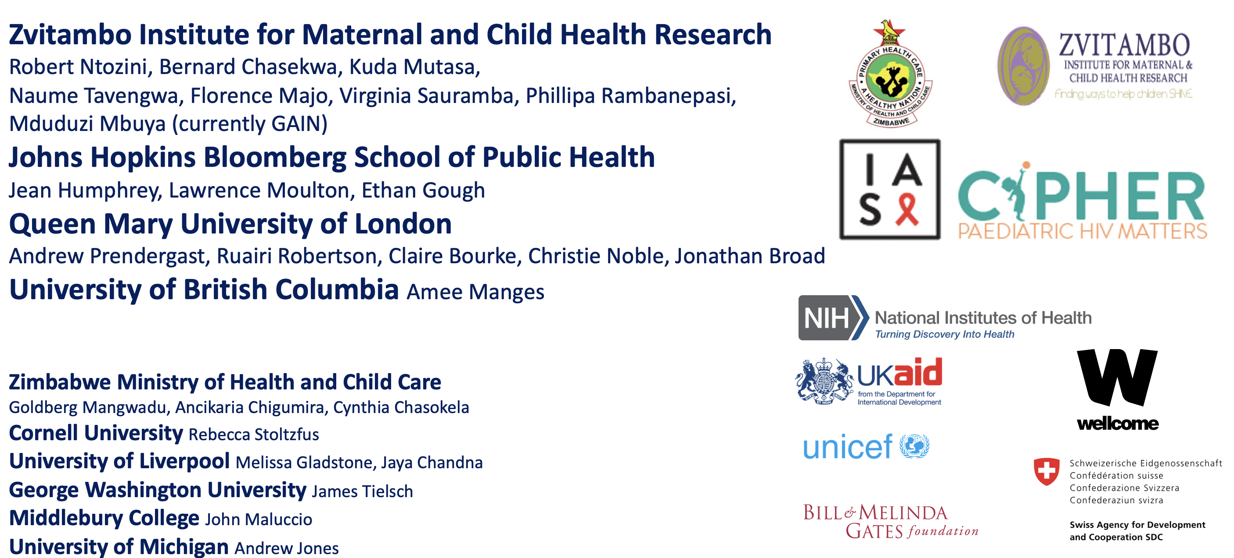
Collaborators and funders
, Paul Kelly

